Slide 1
Support from the Careers Service
Kirsten Roche
Careers & Employability Manager

Slide 2

University of Edinburgh context
Notes:
.

Slide 3

Careers Service context

Slide 4
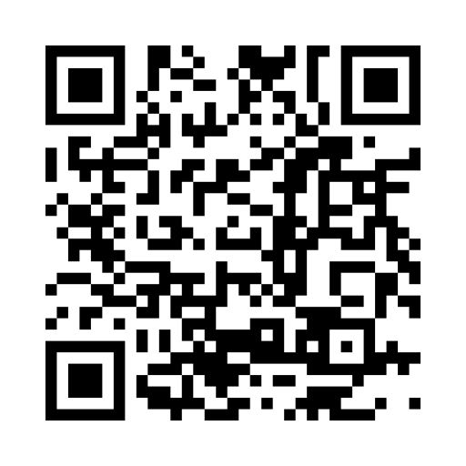
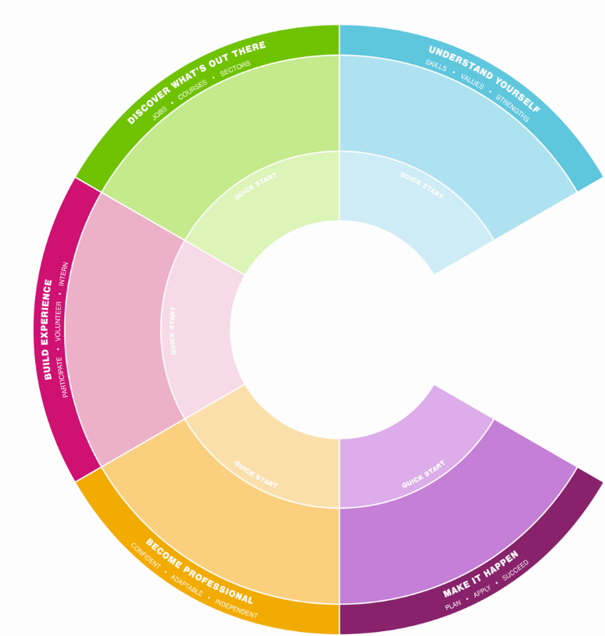
International Student Hub
Exploring your career options
Building experience, including internships
Working part-time
Making applications
Support with applying for further study/PhDs

Slide 5
Subscription services
The Careers Service has paid for subscriptions to a number of key platforms to support our international students.
Student Circus – platform specifically for international students. Advertising
visa-sponsored graduate job roles in the UK as well as jobs in other
countries. It also has advice on navigating the labour market in over 35 countries
CareerSet - gives 24/7 access to personalised feedback and advice on CV, cover letter and LinkedIn profile
Graduates First – provides access to a large number of example aptitude
tests, assessment centre activities and automated practice interviews

Slide 6
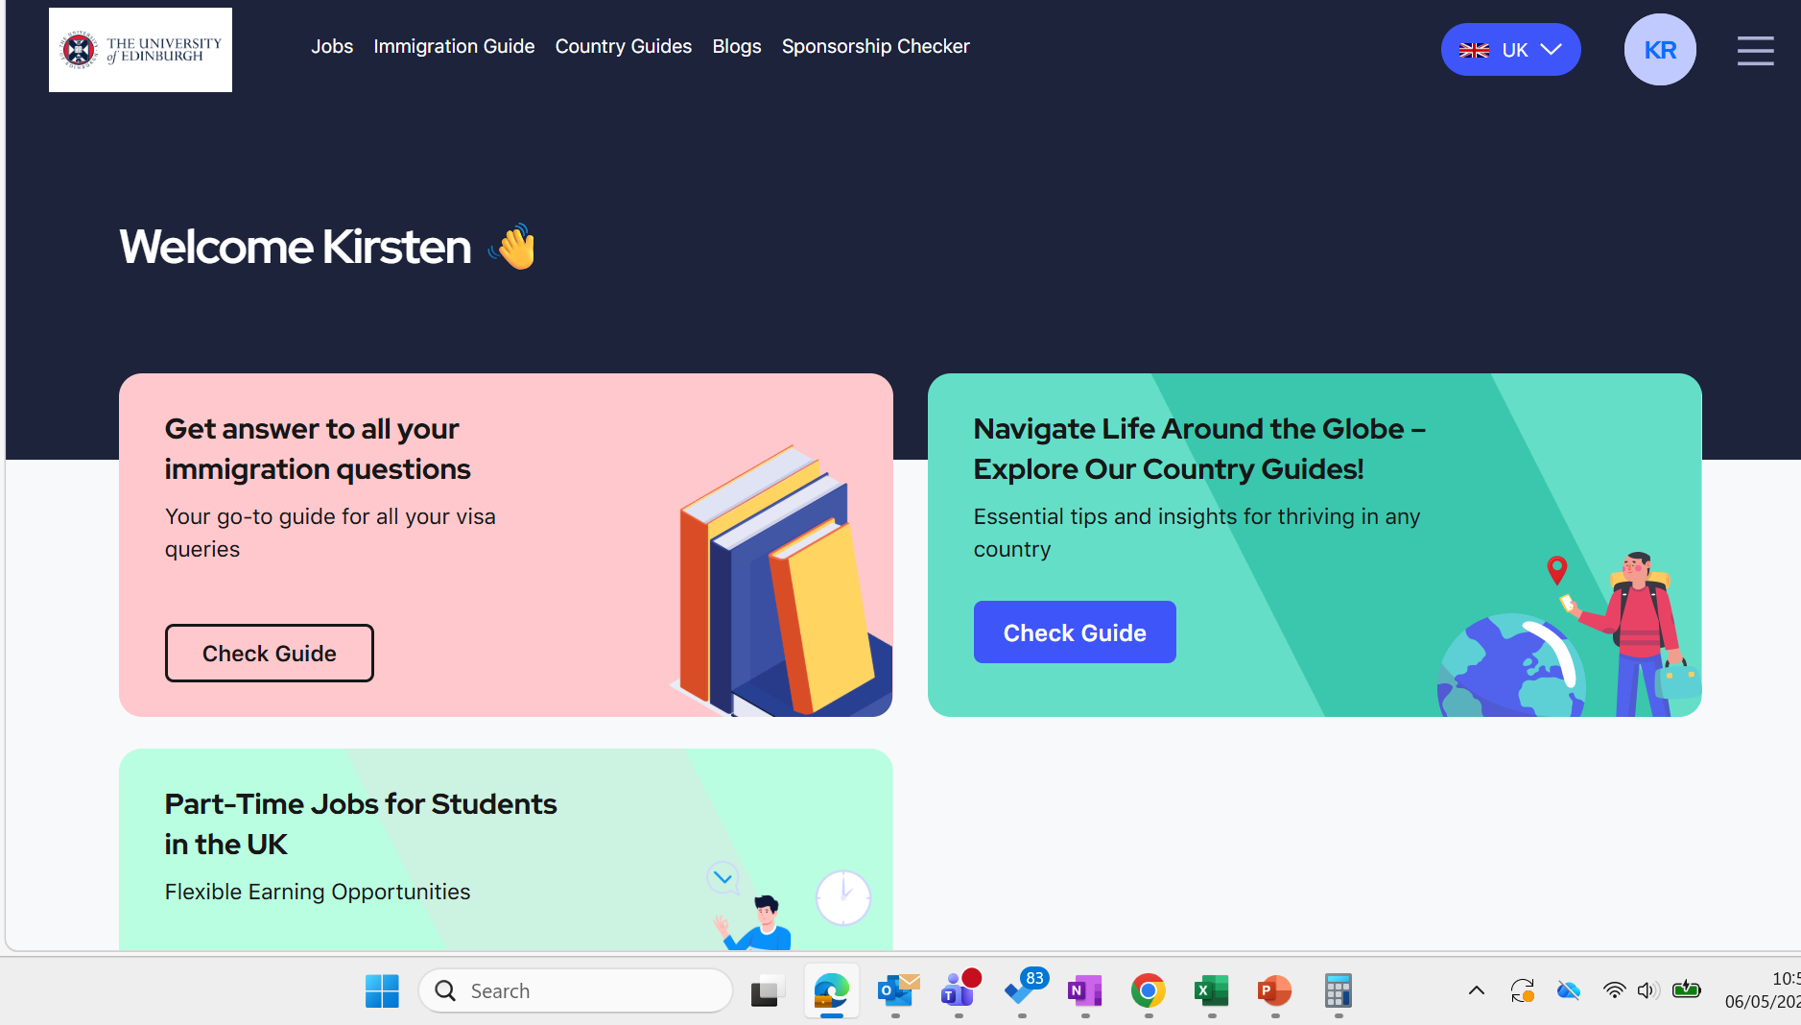
Student Circus homepage

Slide 7



Employer engagement

Slide 8
Support for working in the UK
Support with working during studies, including information on how to obtain a National Insurance Number
Web resources outlining the process to stay in the UK and work
Sessions on working in the UK as a graduate, run in collaboration with our Student Immigration Service
Clear guidance in fair guides on who is open to recruiting international students
Support from our team – all of whom are highly experienced in working with international students

Slide 9
Challenges of working in the UK
Confidence in graduate visa system among employers
Competition from UK students
Graduate recruitment timelines – especially for PG students
Understanding UK recruitment and culture & English language ability
Salary thresholds after the graduate visa period

Slide 10
Support with returning home
Advertise vacancies on MyCareerHub
Appointments offered online at a range of times so can be access by different time zones
Sessions delivered online and recorded
We use RED social media for Chinese students to promote relevant jobs and events
Access to Student Circus resources
Dedicated Finding Work in China webpages: https://careers.ed.ac.uk/jobs-and-internships/finding-graduate-jobs/finding-work-outside-the-uk/finding-work-in-china

Slide 11


Useful links
Careers Service: https://careers.ed.ac.uk/
International Student Hub: https://careers.ed.ac.uk/international-students
& @uofedcareers

