Slide 1

Reading India &
Southeast Asia
from Edinburgh
A roster of expertise across forty years of published scholarship.
15
145+
7
1987 - 2026
Scholars
Publications
Span of years
Disciplines
School of Social and Political Science · University of Edinburgh

Slide 2
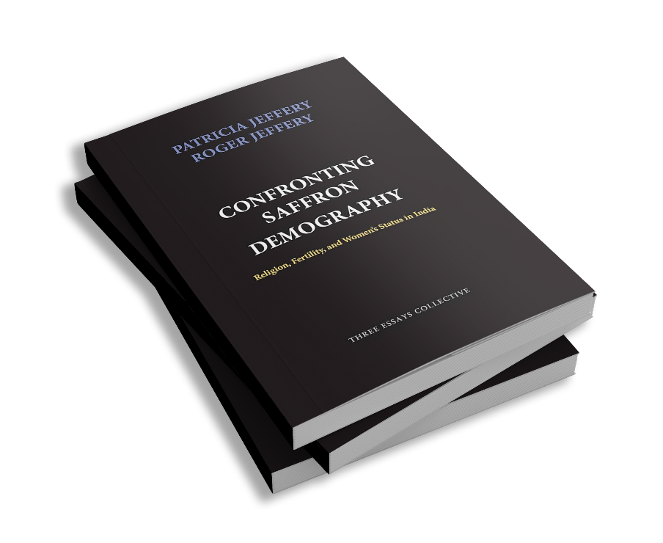
SOCIOLOGY
Patricia Jeffery
Rural North India · Gender · Islam · Demography
SELECTED PUBLICATIONS · 21 TOTAL IN SPS RESEARCH EXPLORER
2020 chapter
Delayed Periods and Falling Babies: Pregnancy Loss in Rural North India
2014 chapter
Underserved and Overdosed? Muslims and the Pulse Polio Initiative in Rural North India
2008 article
Disputing Contraception: Muslim Reform, Secular Change and Fertility
2006 book
Confronting Saffron Demography: Religion, Fertility, and Women's Status in India
School of Social and Political Science · University of Edinburgh

Slide 3
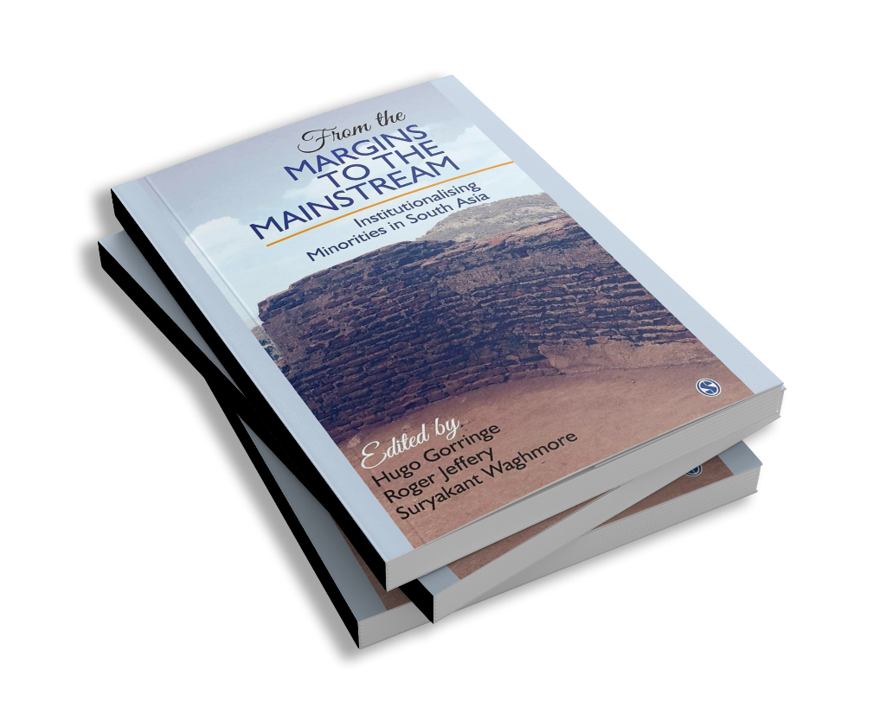
SOCIOLOGY
Roger Jeffery
India · Health · Pharmaceuticals · Higher Education
SELECTED PUBLICATIONS · 21 TOTAL IN SPS RESEARCH EXPLORER
2021 book
Reforming Education and Challenging Inequalities in Southern Contexts
2018 chapter
Structure, Organization and Knowledge of the Indian Clinical Trials Industry
2016 book
From the Margins to the Mainstream: Institutionalising Minorities in South Asia
2011 article
Trust and the Regulation of Pharmaceuticals: South Asia in a Globalised World
School of Social and Political Science · University of Edinburgh

Slide 4
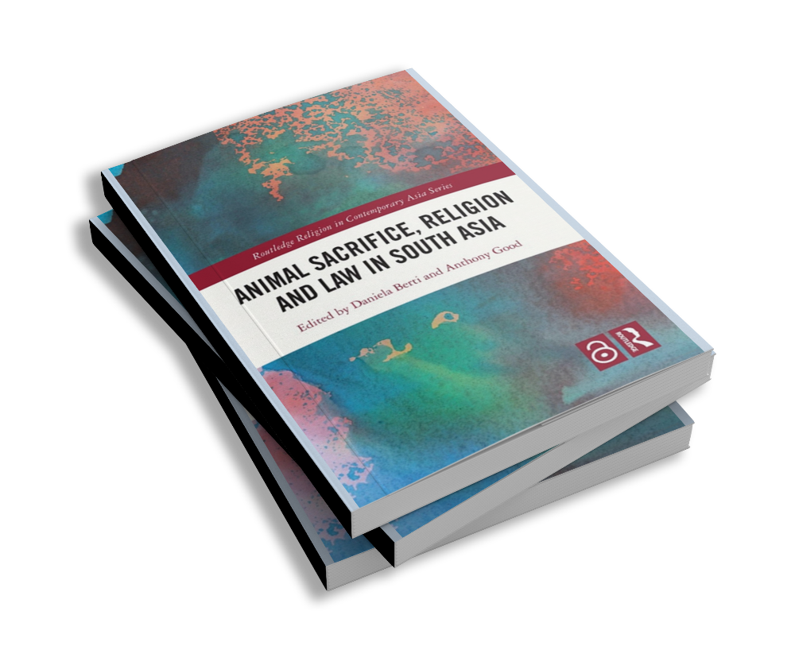
SOCIAL ANTHROPOLOGY
Anthony Good
Tamil Nadu · Sri Lanka · Religion · Law
SELECTED PUBLICATIONS · 14 TOTAL IN SPS RESEARCH EXPLORER
2023 book
Animal Sacrifice, Religion and Law in South Asia
2015 book
Of Doubt and Proof: Ritual and Legal Practices of Judgment
2004 book
Worship and the Ceremonial Economy of a Royal South Indian Temple
1991 book
The Female Bridegroom: Life-Crisis Rituals in South India and Sri Lanka
School of Social and Political Science · University of Edinburgh

Slide 5
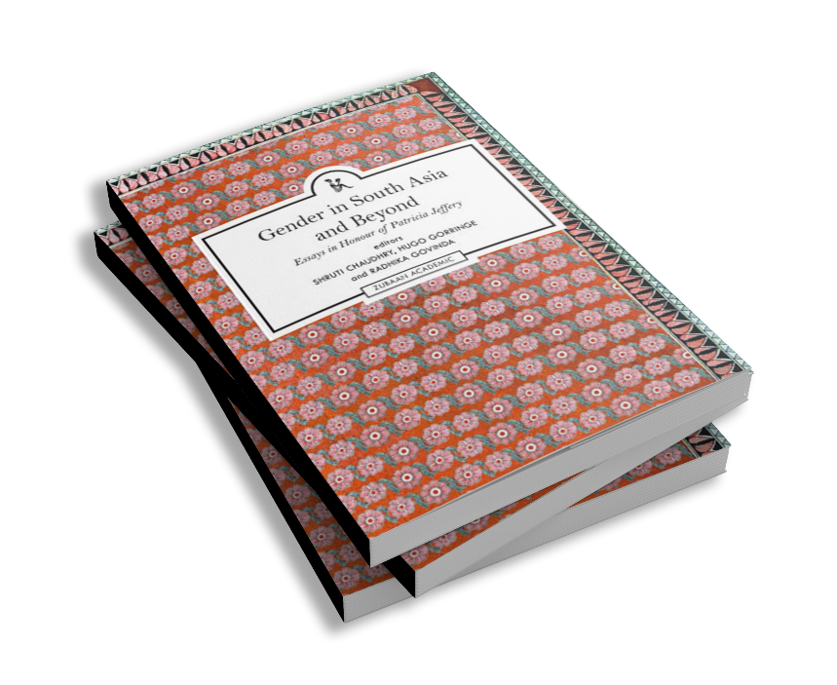
SOCIOLOGY
Hugo Gorringe
Tamil Nadu · Caste · Dalit Movements · Gender
SELECTED PUBLICATIONS · 18 TOTAL IN SPS RESEARCH EXPLORER
2024 book
Gender in South Asia and Beyond: Essays in Honour of Patricia Jeffery
2023 book
Caste in Everyday Life: Experience and Affect in Indian Society
2018 chapter
Rescuing Gender from the Dalit Trap: Caste and Gender in Tamil Dalit Movements
2014 chapter
Legislating for Liberation? Dalit Electoral Politics and Social Change in Tamil Nadu
School of Social and Political Science · University of Edinburgh

Slide 6
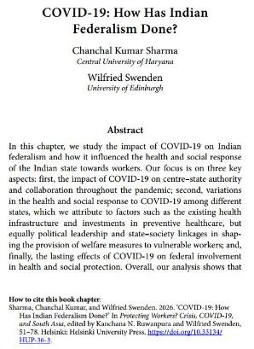
POLITICS & INTERNATIONAL RELATIONS
Wilfried Swenden
India · Federalism · Territorial Politics · South Asia
SELECTED PUBLICATIONS · 16 TOTAL IN SPS RESEARCH EXPLORER
2025 chapter
Covid-19: How Has Indian Federalism Done?
2022 chapter
India: An Emerging or Fragile Federation?
2018 chapter
Territorial Politics in South Asia: Accommodation and Majoritarianism
2018 article
Governing Diversity in South Asia: India and Pakistan
School of Social and Political Science · University of Edinburgh

Slide 7
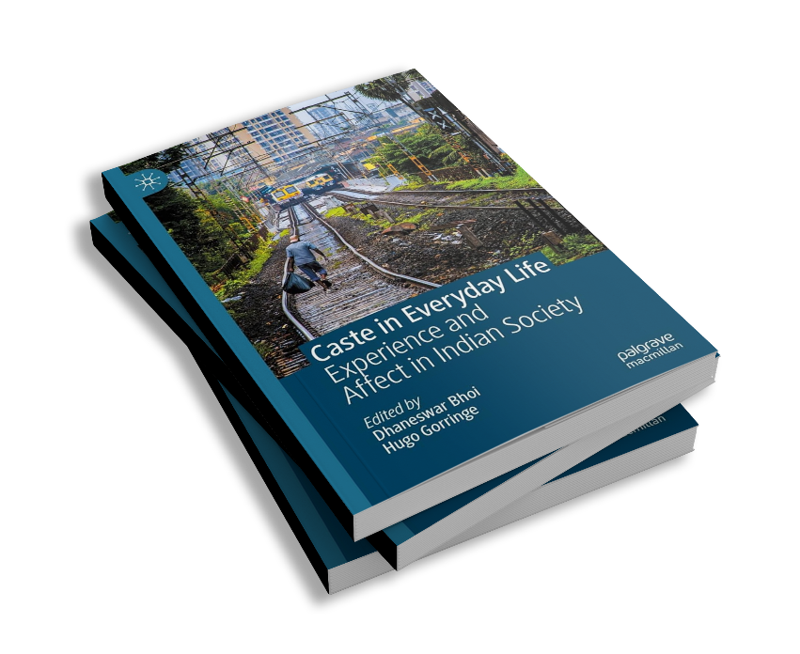
SOCIOLOGY · SOUTH ASIAN STUDIES
Dhaneswar Bhoi
India · Dalit Studies · Higher Education · Caste
SELECTED PUBLICATIONS · 11 TOTAL IN SPS RESEARCH EXPLORER
2025 article
Caste, Mental Health and Self-Harm: Dalit Students at the Indian University
2023 book
Caste in Everyday Life: Experience and Affect in Indian Society
2022 chapter
Educational Development and Muslims: Higher Education in India
2021 chapter
Article 370, Ambedkar and National Integration
School of Social and Political Science · University of Edinburgh

Slide 8
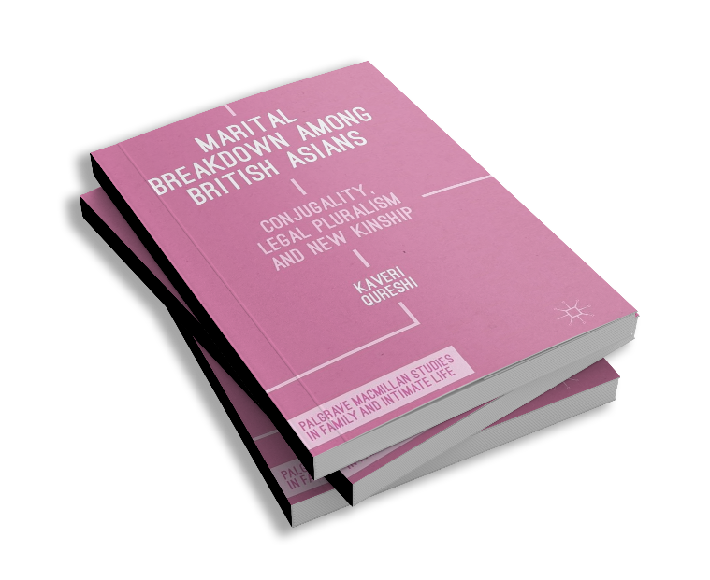
SOCIAL POLICY
Kaveri Qureshi
British South Asia · Gender · Health · Diaspora
SELECTED PUBLICATIONS · 11 TOTAL IN SPS RESEARCH EXPLORER
2025 article
Relational Logics of Child Maintenance and Post-Separation Economic Abuse
2021 chapter
Of Salsa and singlemuslim.com: Identity Shifts in Middle-Aged Muslim Women
2018 chapter
Womanhood Implies Travel: Punjabi Marriage Migration between India and Britain
2016 book
Marital Breakdown among British Asians: Conjugality, Legal Pluralism and New Kinship
School of Social and Political Science · University of Edinburgh

Slide 9

SOCIAL ANTHROPOLOGY
Jacob Copeman
India · Religion · Blood · Secularism
SELECTED PUBLICATIONS · 8 TOTAL IN SPS RESEARCH EXPLORER
2021 chapter
Anonymity and Transgression: Caste, Social Reform, and Blood Donation in India
2018 article
Ungiven: Philanthropy as Critique
2015 article
Secularism's Names: Commitment to Confusion and the Pedagogy of the Name
2012 book
Veins of Devotion: Blood Donation and Religious Experience in North India
School of Social and Political Science · University of Edinburgh

Slide 10
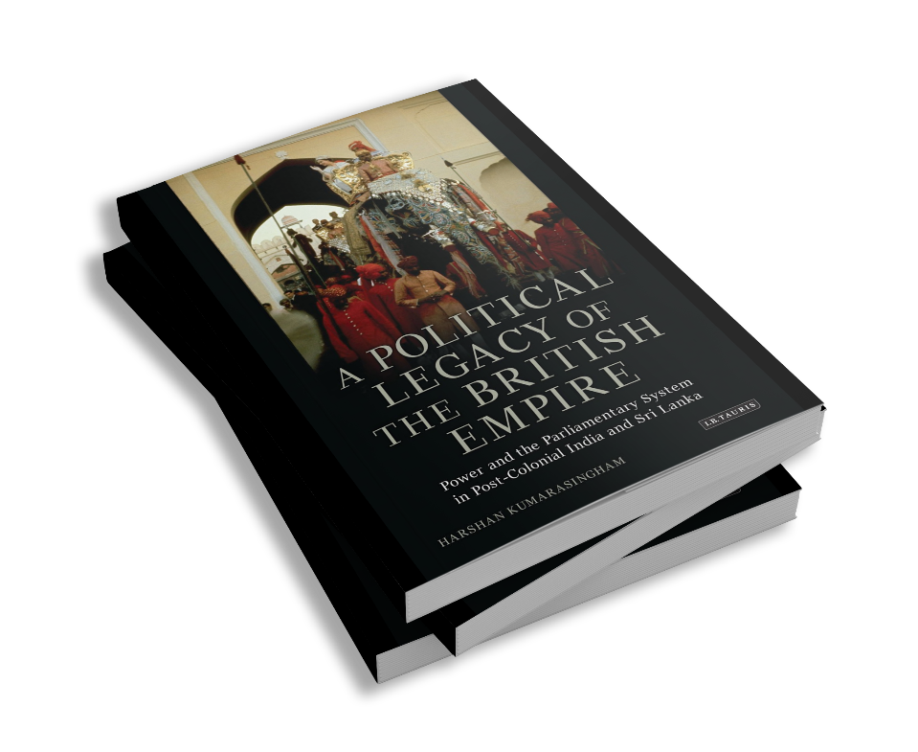
POLITICS & INTERNATIONAL RELATIONS
Harshan Kumarasingham
Sri Lanka · India · Constitutional History · Decolonisation
SELECTED PUBLICATIONS · 7 TOTAL IN SPS RESEARCH EXPLORER
2023 chapter
Indian Summer or Conservative Winter? Churchill's Final Fall from Power
2023 article
The Malay Monarchies in Constitutional and Social Conception
2017 article
Sir Ivor Jennings and the Manipulation of Westminster Style Democracy
2012 book
A Political Legacy of the British Empire: India and Sri Lanka
School of Social and Political Science · University of Edinburgh

Slide 11
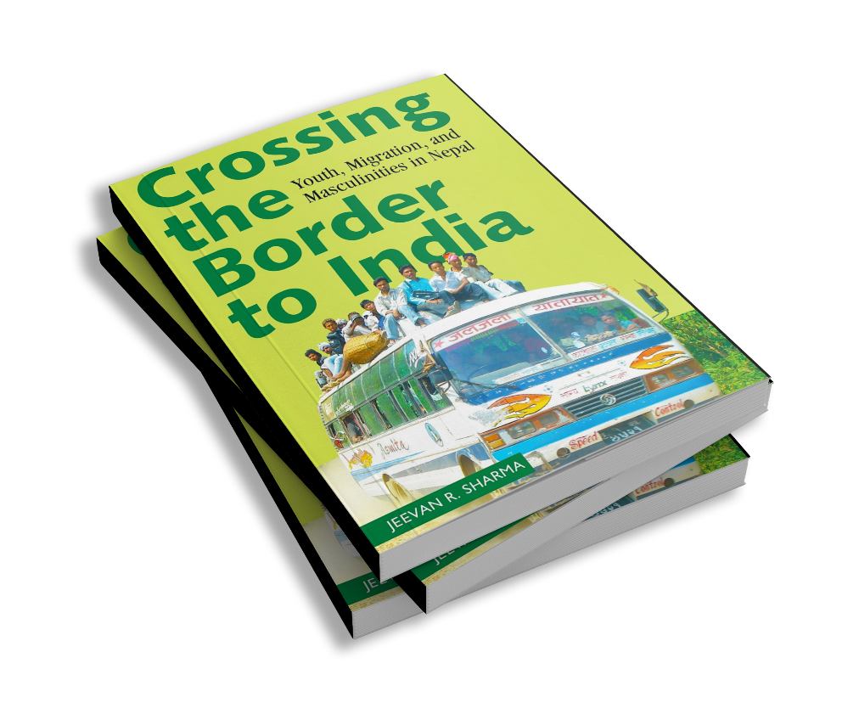
INTERNATIONAL DEVELOPMENT
Jeevan Sharma
Nepal · India · Migration · Masculinity
SELECTED PUBLICATIONS · 8 TOTAL IN SPS RESEARCH EXPLORER
2022 chapter
Migrants and Health: Low-Income Migrants in Punjab and Assam
2021 article
Covid-19 and the Precarity of Low-Income Migrant Workers in Indian Cities
2019 book
Crossing the Border to India: Youth, Migration and Masculinities in Nepal
2013 chapter
On the Way to India: Nepali Rituals of Border Crossing
School of Social and Political Science · University of Edinburgh

Slide 12
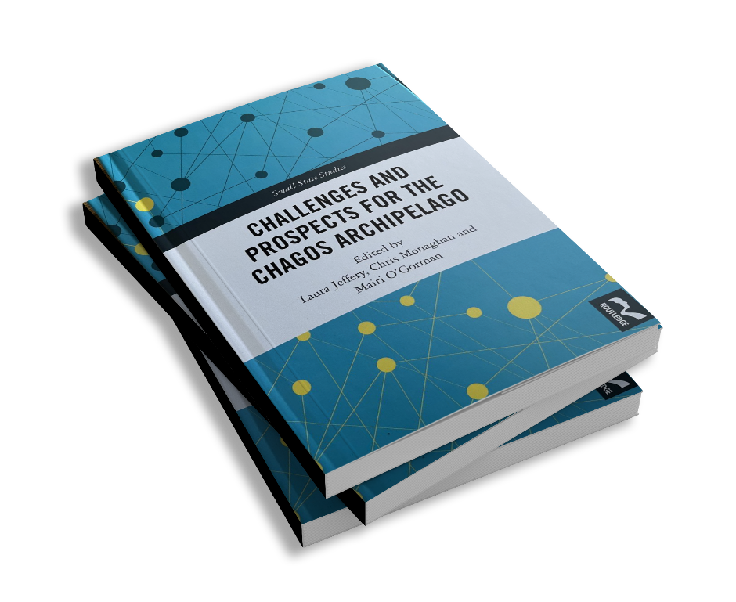
SOCIAL ANTHROPOLOGY
Laura Jeffery
Mauritius · Chagos Archipelago · Indian Ocean · Displacement
SELECTED PUBLICATIONS · 8 TOTAL IN SPS RESEARCH EXPLORER
2024 book
Challenges and Prospects for the Chagos Archipelago
2021 chapter
Encountering Chinese Development in the Maldives
2018 chapter
'For Mauritians, Joy; For Chagossians, Sadness': Mauritian Independence
2008 chapter
'Give Us Back Diego Garcia': Activists in the Indian Ocean
School of Social and Political Science · University of Edinburgh

Slide 13
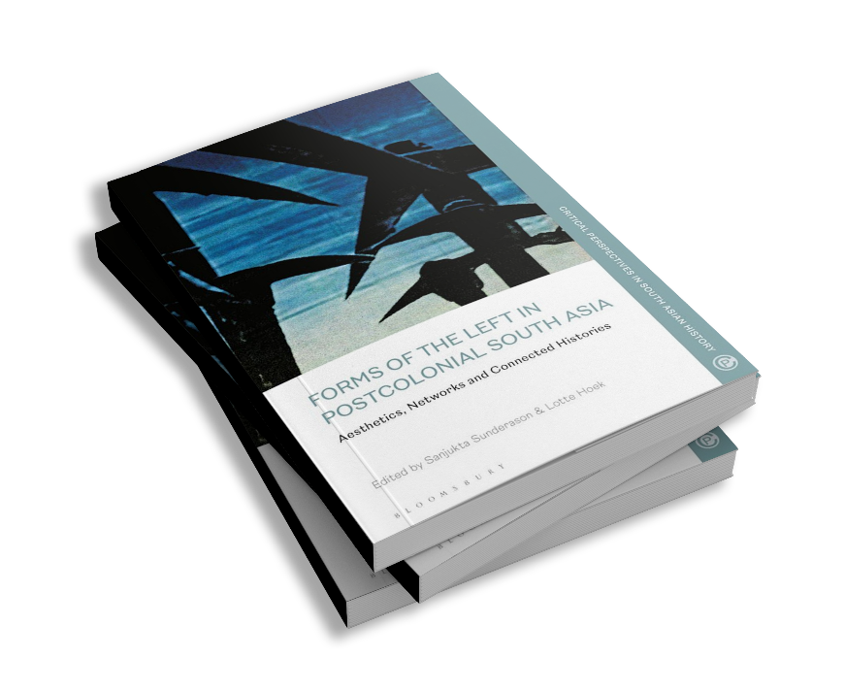
SOCIAL ANTHROPOLOGY
Lotte Hoek
Bangladesh · East Pakistan · Cinema · Visual Culture
SELECTED PUBLICATIONS · 6 TOTAL IN SPS RESEARCH EXPLORER
2024 chapter
A Screen in the Crowd: Film Societies and Political Protest in Bangladesh
2022 book
Forms of the Left in Postcolonial South Asia: Aesthetics and Networks
2021 chapter
Films in the Diplomatic Bag: The Foreign Mission Film in East Pakistan
2010 article
Cut-Pieces as Stag Film: Bangladeshi Pornography in Action Cinema
School of Social and Political Science · University of Edinburgh

Slide 14

SOCIAL ANTHROPOLOGY
Stefan Ecks
India · Pharmaceuticals · Mental Health · Anthropology of Medicine
SELECTED PUBLICATIONS · 6 TOTAL IN SPS RESEARCH EXPLORER
2022 book
Living Worth: Value and Values in Global Pharmaceutical Markets
2013 book
Eating Drugs: Psychopharmaceutical Pluralism in India
2013 chapter
Public-Private Mixes: The Market for Anti-Tuberculosis Drugs in India
2010 chapter
Near-Liberalism: Global Corporate Citizenship and Pharmaceutical Marketing in India
School of Social and Political Science · University of Edinburgh

Slide 15
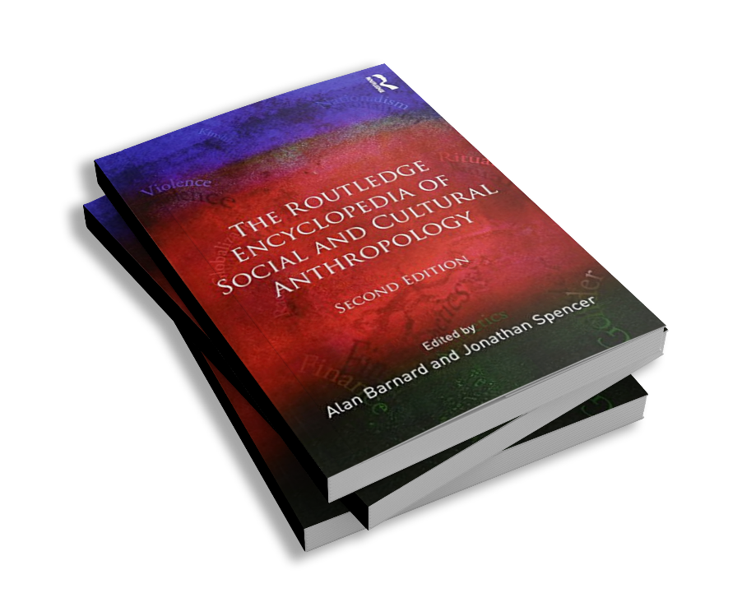
SOCIAL ANTHROPOLOGY
Jonathan Spencer
Sri Lanka · South Asia · Anthropology of Politics
SELECTED PUBLICATIONS · 4 TOTAL IN SPS RESEARCH EXPLORER
2019 chapter
Afterword: We Have Other Ideas
2018 chapter
Pillayar and the Politicians: Secularization at the End of Sri Lanka's Civil War
2016 article
Securitization and Its Discontents: The End of Sri Lanka's Long Post-War?
2014 article
Anthropology, Politics, and Place in Sri Lanka: Reflections from an Island Adrift
School of Social and Political Science · University of Edinburgh

Slide 16
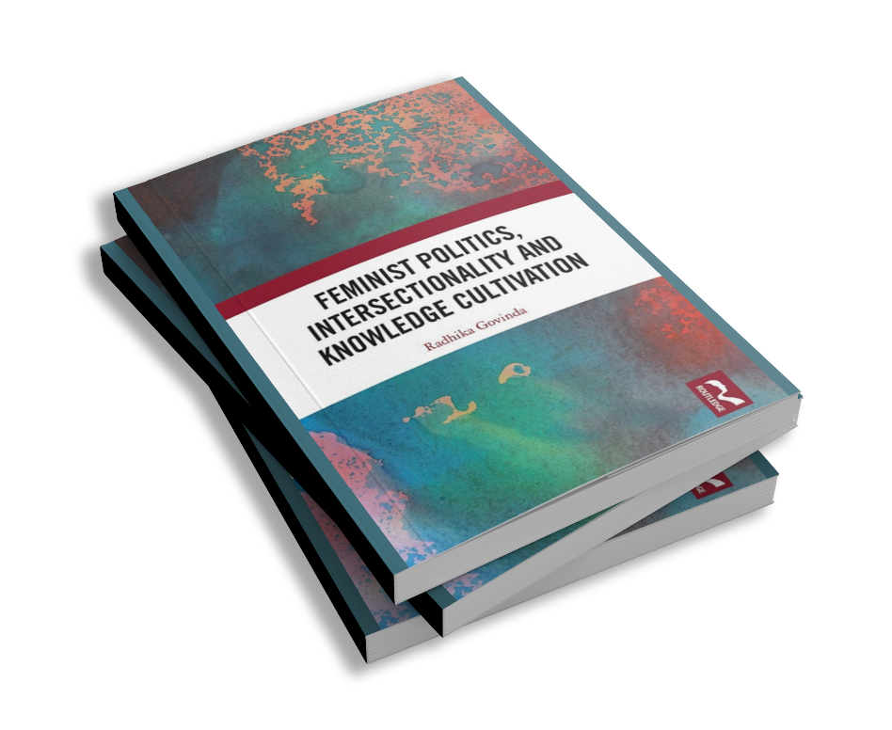
SOCIOLOGY
Radhika Govinda
India · Gender · Feminism · Dalit Studies
SELECTED PUBLICATIONS · 8 TOTAL IN SPS RESEARCH EXPLORER
2025 book
Feminist Politics, Intersectionality and Knowledge Cultivation
2024 book
Gender in South Asia and Beyond: Essays in Honour of Patricia Jeffery
2020 book
Doing Feminisms in the Academy: Identity, Pedagogy and Critical Classrooms
2017 chapter
Different Dalit Women Speak Differently: Narratives of Agency from Rural Uttar Pradesh
School of Social and Political Science · University of Edinburgh

Slide 17
And many others.
Across the School of Social and Political Science, almost two hundred scholars contribute to the study of India and Southeast Asia - in sociology and anthropology, politics and policy, science studies, development, and beyond.
Edinburgh Research Explorer · research.ed.ac.uk
School of Social and Political Science · University of Edinburgh

