Slide 1

Mathematics MSc Programmes and Industry

Slide 2
Industry-Driven Teaching
Our MSc students have access to industry-driven teaching, including:
Industrial Mathematics
Operational Research in the Energy Industry
Optimization Methods in Finance
Research Skills
Stochastic Analysis in Finance
Topics in Applied Operational Research

Slide 3
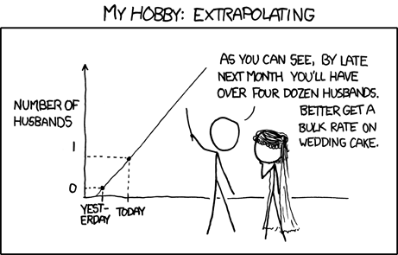
Mathematical Modelling – What It’s Not
https://xkcd.com/605

Slide 4
Mathematical Modelling – What It Is
The development of a mathematical representation of an industrial (physical, biological, chemical, economic,…) situation.
“All models are wrong but some are useful.”
[George Box (Statistician, 1978)]
Models are crucial in a huge range of industries.

Slide 5
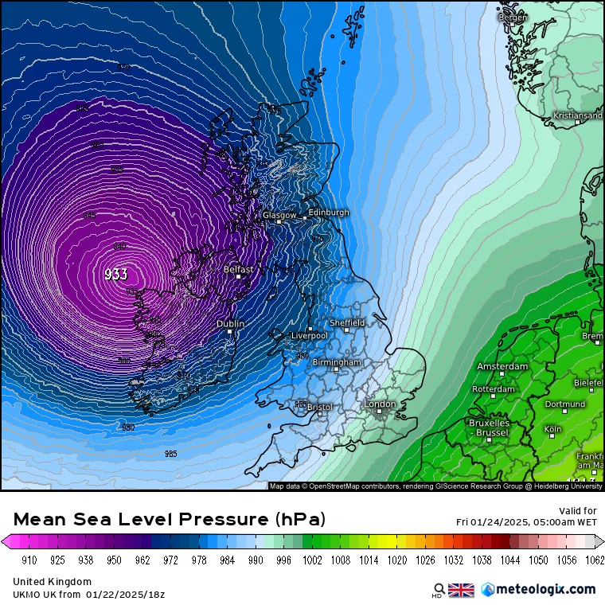
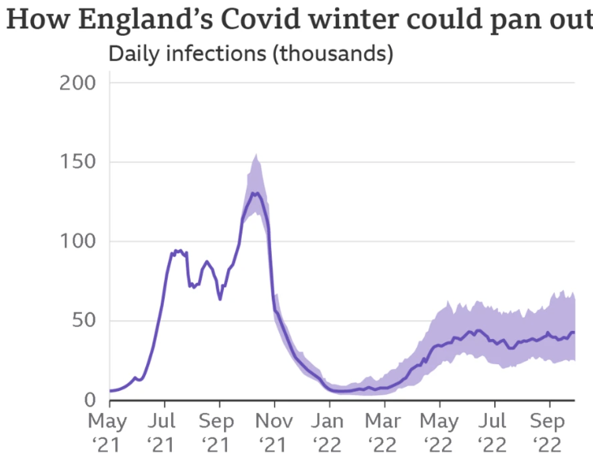

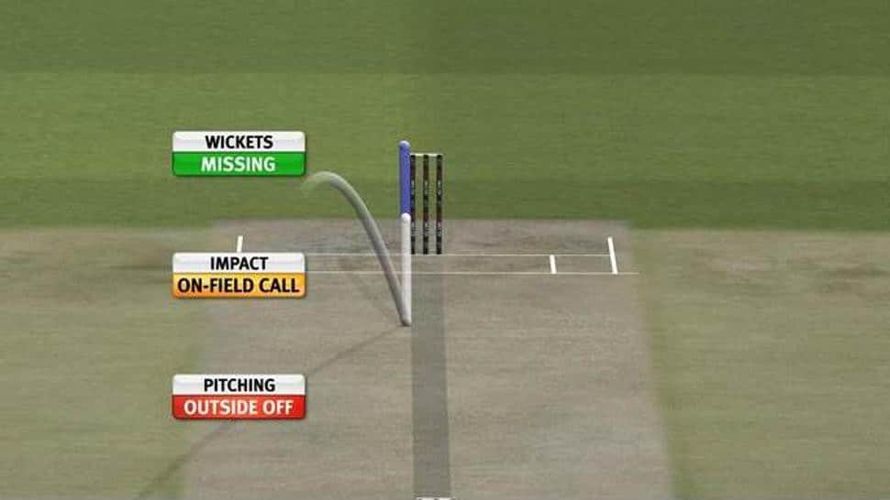
Mathematical Modelling - Examples

Slide 6
Mathematical Modelling - Process

Slide 7
Modelling the Roman Empire
We’re going to have a go at thinking about the first part of the modelling process.
We want to model the rise and fall of the Roman Empire.
No mathematical background is required and there’s (almost) no wrong answers!
https://www.youtube.com/watch?v=WaxeyHAOTWA

Slide 8
Dissertation with Industry
Students doing an industry-based project that have then joined the company.
Examples:
  Flexitricity
  Edinburgh Airport
  Sopra Steria
  GORS
  RBS

Slide 9
Challenges
MSc Challenge
  Interdisciplinary e.g., Earth Observation
OR Challenge
  Police Scotland

Slide 10
Careers in
Speakers showcase different career paths.
Workshops help students develop employability skills.
Demonstrate how a mathematics background is useful in a wide range of industries.
Students get advice on graduate programmes and applications.

Slide 11
Business Development Executives (BDEs)
Student Industry Engagement
Key Activities
Facilitate relationships between the School and external organisations
Source and manage external MSc dissertation projects
Represent the School at external industry events
Connect organisations with our students
Facilitate events and activities related to Knowledge Exchange (KE) and Impact

