Slide 1
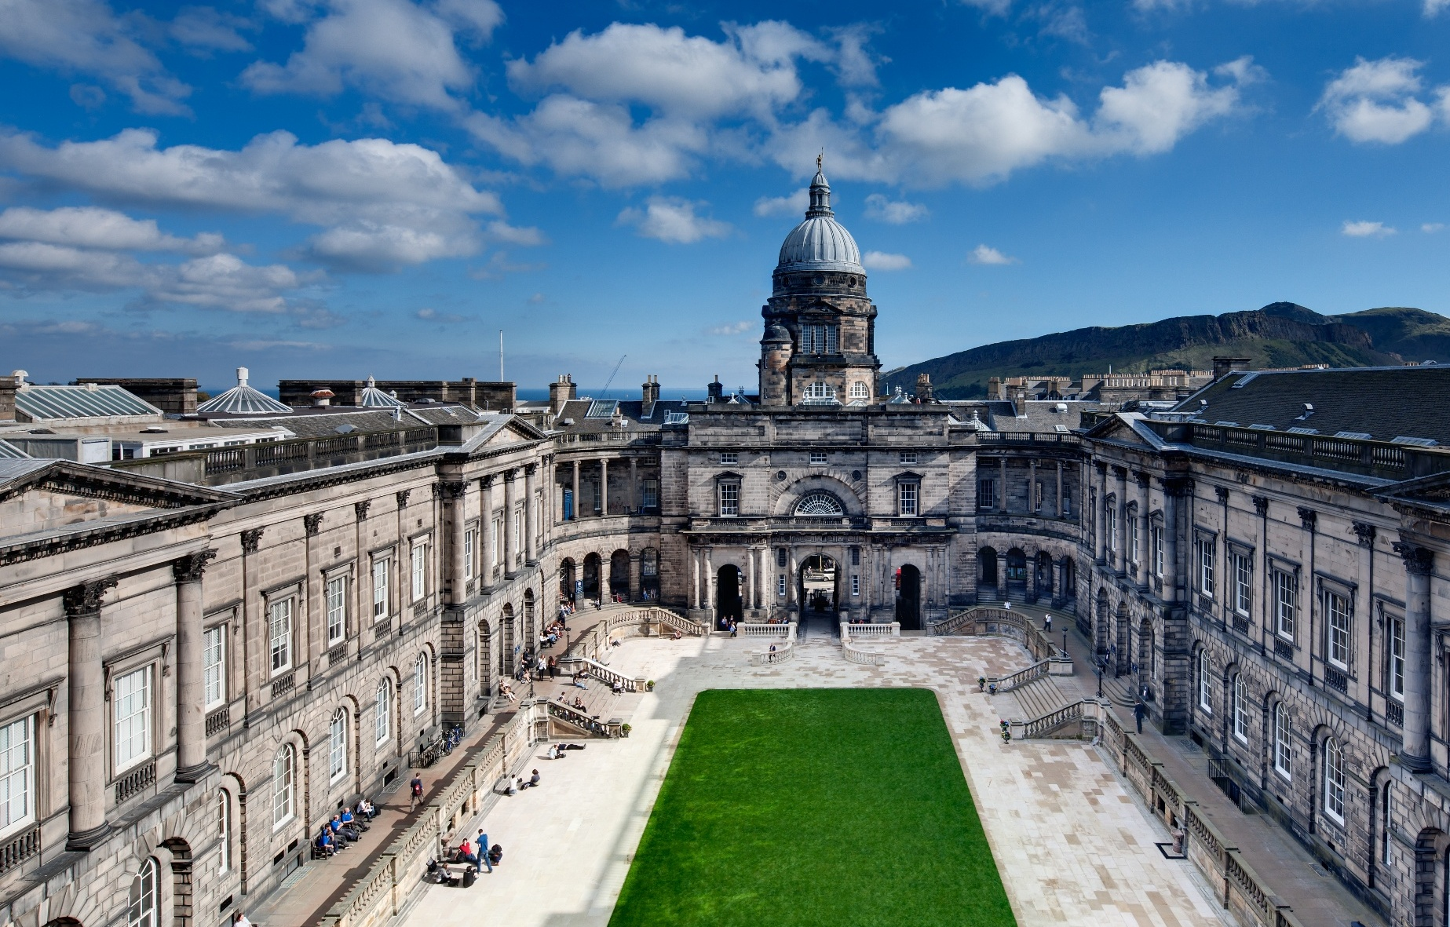


Studying at
Edinburgh Law School
Lorna Richardson
Director of Postgraduate Taught Studies
&
Dr Francisco Quintana
Lecturer in Global Law

Slide 2
What this session will cover
Why choose Edinburgh Law School?
Undergraduate Degrees
Masters Degrees
- Our students
- How we teach
- Beyond the classroom
- Careers

Slide 3

Why choose Edinburgh Law School?
Established in 1707, we are one of the world's leading law schools, currently ranked 15th in the world for law (QS World University Rankings by Subject 2026)
Opportunity to be part of a diverse and welcoming community of students from all around the world
Led by academics who are experts in their field
Benefit from world-class facilities and study in and around the iconic Old College
An active calendar of events and a range of opportunities outside the classroom
An extraordinary step to the next stage of your career

Slide 4

Undergraduate Degrees
  Law (Ordinary and Hons) LLB
  Joint Honours LLB (Hons)
  Law (Graduate Entry) LLB (Ord)
  Global Law LLB (Hons)
Notes:
LLB Hons & Ord
Scots Law degree required for those planning to enter the Scottish legal profession
You will also be made familiar with the law and legal systems of the other parts of the UK, the EU, and the wider world.
Honours years (years 3 and 4) give you the opportunity to study a wide range of subjects to extend your specialist knowledge
Opportunity to participate in legal moots
Accredited by the Law Society of Scotland - you will be required to study certain courses to graduate with a fully qualifying degree.
Joint Hons
A joint degree qualification shows employers that you can work across a range of disciplines.
If you intend to proceed to qualification as a lawyer in Scotland, you will need to study additional courses.
Grad LLB
Accelerated route to a qualifying degree in Scots law – two years
Intended for those who already hold a degree-level qualification and who wish to obtain an undergraduate qualification in law

Slide 5

Global Law LLB (Hons)
Designed to address the increasingly international / transnational / global nature of legal work
Provides you with the skills to adapt, innovate and succeed in a globally oriented legal career
Further develop your global perspective and networks through a compulsory 3rd year abroad
Excellent grounding for a wide range of careers in areas such as: international organisations, financial services, politics, journalism, public policy, civil society and advocacy work, and government work
Does not provide you with a qualification to practice law in Scotland

Slide 6
Our Taught Masters Degrees (on campus)
LLM in Commercial Law
LLM in Comparative Private Law
LLM in Corporate Law
LLM in Criminal Law and Criminal Justice
MSc in Criminology and Criminal Justice
LLM in European Law*
MSc in Global Crime, Justice and Security
LLM in Global Environment and Climate Change Law
  LLM in Human Rights
  LLM in Innovation, Technology and the Law
  LLM in Intellectual Property Law
  LLM in International Banking Law and Finance
  LLM in International Economic Law
  LLM in International Law
  LLM in Law (General)
  LLM in Medical Law and Ethics
* Re-developed as LLM in European and Transnational Law – planned for AY 27/28

Slide 7

Our students
A diverse and welcoming postgraduate community:
Our Masters students come from over 60 different countries around the globe
Cohort of highly qualified students, with diverse backgrounds which makes for dynamic teaching experience
Communities within and across programmes

Slide 8
Learning on a Masters Degree
Teaching staff are leading researchers in their field
Typically a weekly two-hour interactive seminar for each course
Active participation in discussions and advance reading expected
Classes may also involve lectures, class debates, individual presentations, or group exercises for example
Courses use a range of take-home assessments (e.g. essays, reports, advice on case-studies, group work) or in-class work (oral presentations, class participation, mini-moots)
Dissertation

Slide 9
Beyond the classroom
Law Student Societies and many other University societies across a wide range of interests
Opportunities to work on academic journals.
Opportunities for research Assistance
Wide-ranging events programme & guest speakers, often via dedicated research centres
Mooting
Career’s advice and access to alumni

Slide 10

Graduate outcomes
Careers all around the world in a range of industries
Examples of roles (recent LLM and MSc graduates):
Legal: Lawyer, Barrister, Judge
Finance: Wealth Executive, In-house Counsel, Global Financial Crime Investigator, Operational Risk Management
Tech: Cyber Security Consultant, Legal Counsel, Data Protection and Compliance Officer, Intelligence Analyst, Contracts Manager
Government: In-house lawyer, Civil Servant, Senior Policy Advisor, Compliance Analyst
Non-profit: Climate & Environmental Lawyer, Policy and Research Officer, Human Rights Policy Analyst
Academia: PhD, Lecturer, Researcher

Slide 11
Any questions?
Visit: www.law.ed.ac.uk
Contact us: pg.law.enquiries@ed.ac.uk

