Slide 1
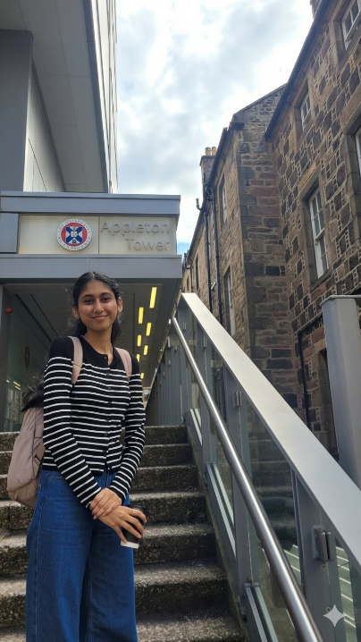
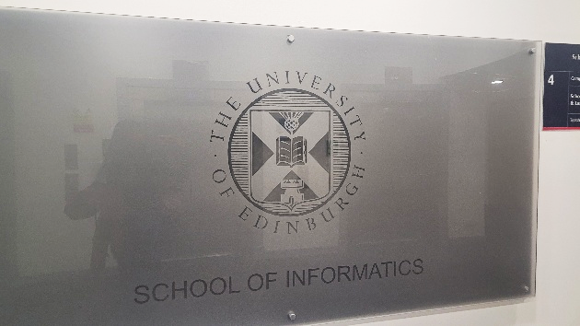
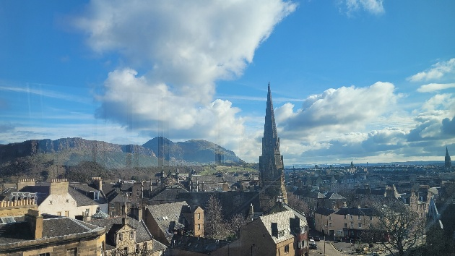
Samriddhi Rawat
(She/Her)
Studying MSc Data Science at the School of Informatics
Background in Economics
Interested in machine learning, sustainability and AI for social good
Glimpse from my first day at UoE

Slide 2
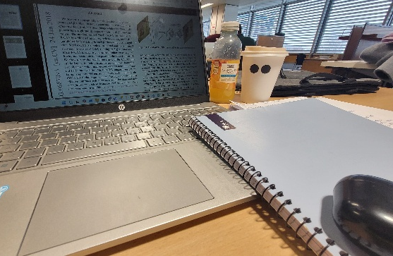
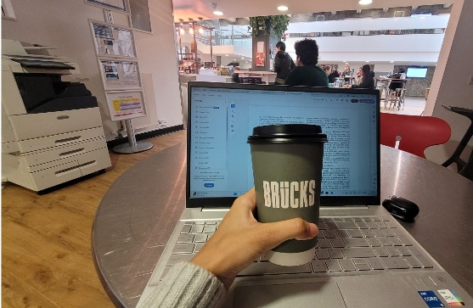
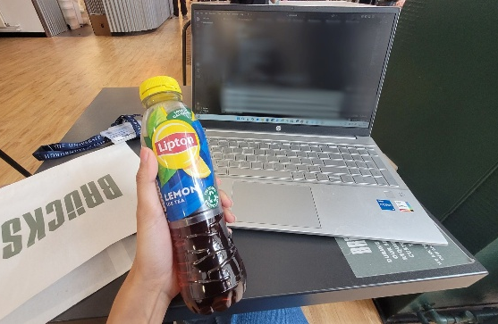
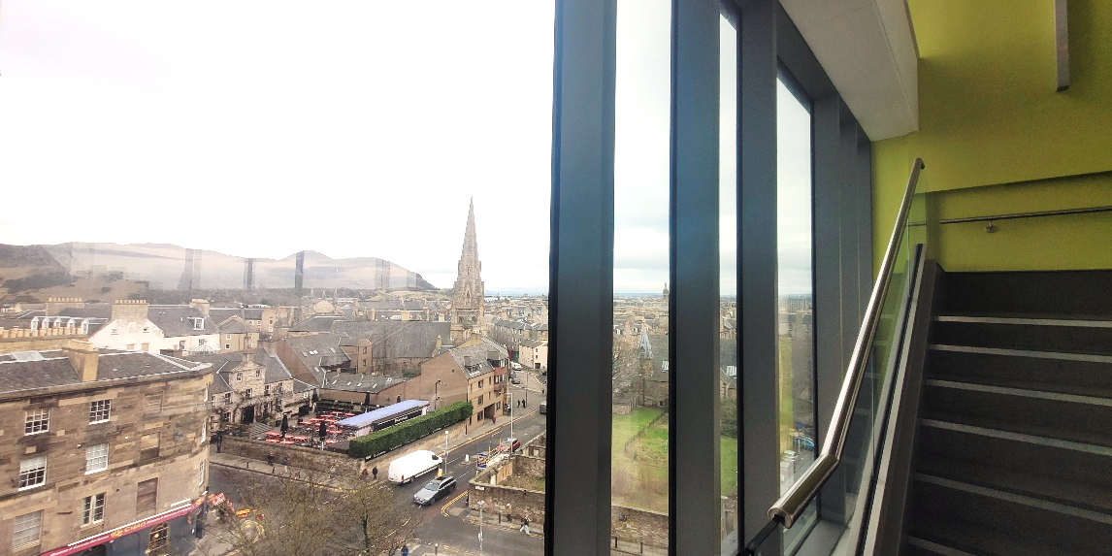
What a Typical Week looks like for “ME”?
Lectures and tutorials during the week
Lab sessions for practical work
Time spent on assignments, projects, and group discussions
Studying in university spaces like the Appleton or the Main Library
Balancing courseworks with social activities

Slide 3
Courses I have taken
SEMESTER- 1
Applied Machine Learning (20 credits)
Introduction to Databases (20 credits)
Distributed Systems (10 credits)
Statistical Programming (10 credits)
Most of the courses I have taken so far have been a combination of all these components
Lectures
Tutorials
Labs
SEMESTER-2
Advanced Topics in Machine Learning (20 credits)
Computer Vision (20 credits)
Informatics Project Proposal (20 credits)
Coursework
Written Exams

Slide 4
Academic & Student Support
Professors & TAs are genuinely approachable
Office hours & Piazza forums keep help always within reach
Student Advisors on hand for academic & personal concerns
University-wide support: career services, wellbeing service, etc..
Peer learning is encouraged through courseworks
Health care and GP on campus
No question is too small!
Because you're never figuring things out alone!

Slide 5


Societies and other activities
Students at the School of Informatics have access to many tech and student communities like CompSoc and Hoppers, which organise tech talks, workshops, and networking events
Outside academics, I enjoy volunteering, practicing yoga and jogging to stay active
Beautiful green spaces like the Meadows & Arthur's Seat are just a short walk from campus

Slide 6
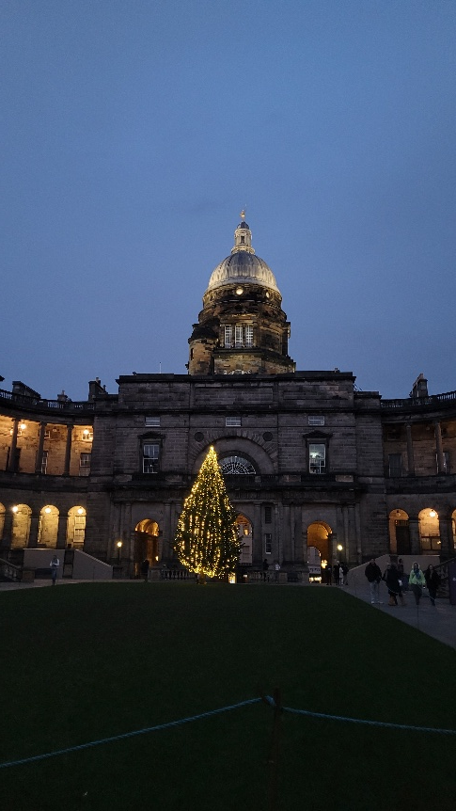
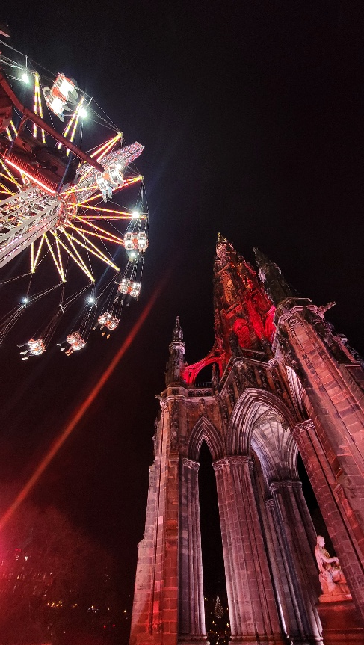
Life in Edinburgh
Edinburgh is a very walkable and scenic city, perfect for exploring on foot.
Many museums, cafes, and historic landmarks are within easy reach of campus
Famous for Edinburgh Festival Fringe in August and Christmas Market + Hogmanay in December.

