Slide 1

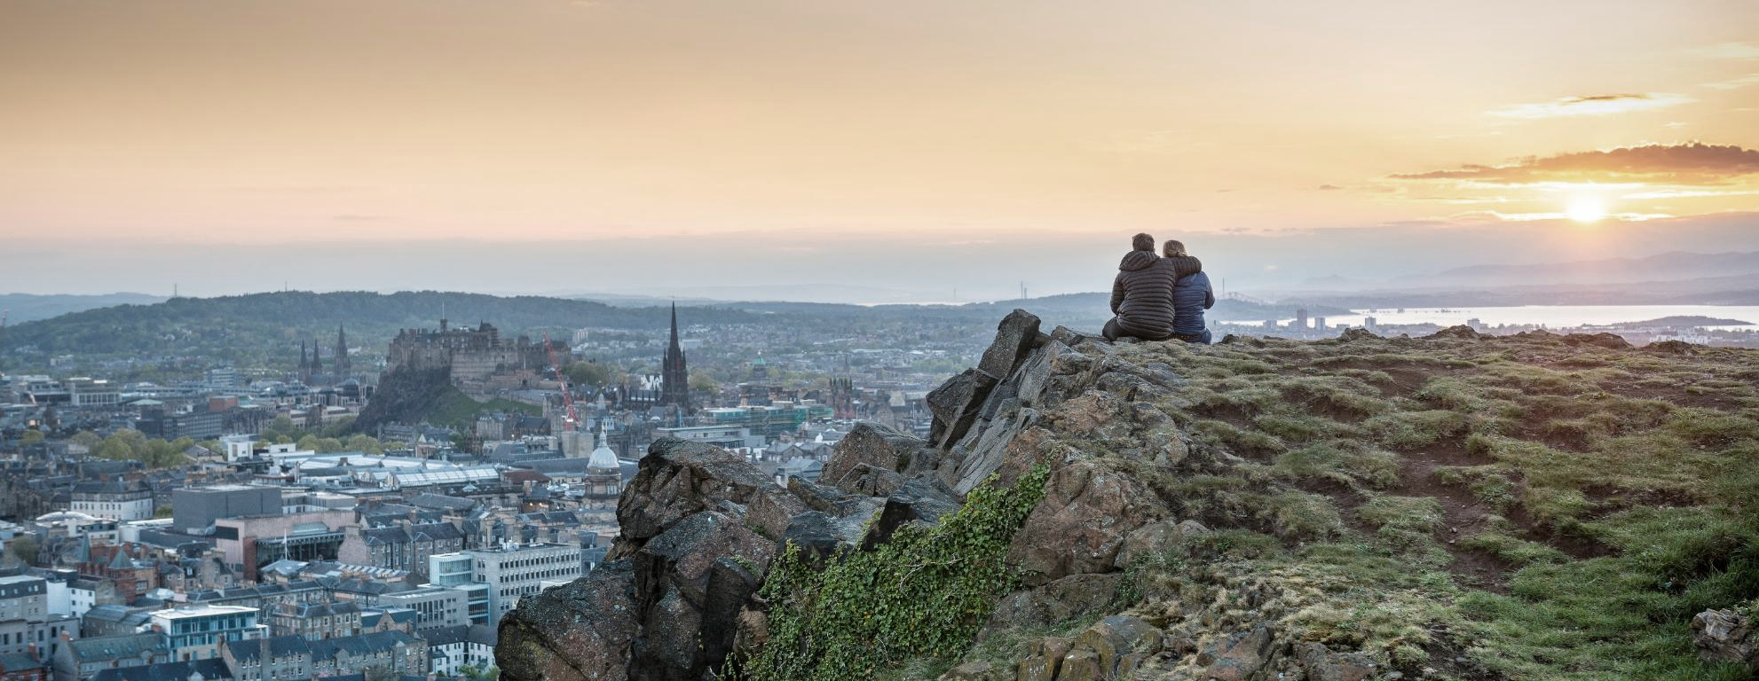
Moray House School of Education and Sport
International Agent Conference 2026

Slide 2
Moray House School of Education and Sport
We are ranked 1st in Scotland and Top 20 in the World* for Education (9th) & Sport (20th).
95% of our MSc graduates entered employment or further study**
We have a warm community and our own city-centre campus.
We are a leading centre for research impact and teaching in education and sport, in Scotland and globally.
Our faculty are experienced practitioners and delivering cutting-edge research in their respective fields.
*QS World Rankings by Subject 2026, **15 months after graduating, Graduate Outcomes Survey 2025
Isle of Skye.

Slide 3
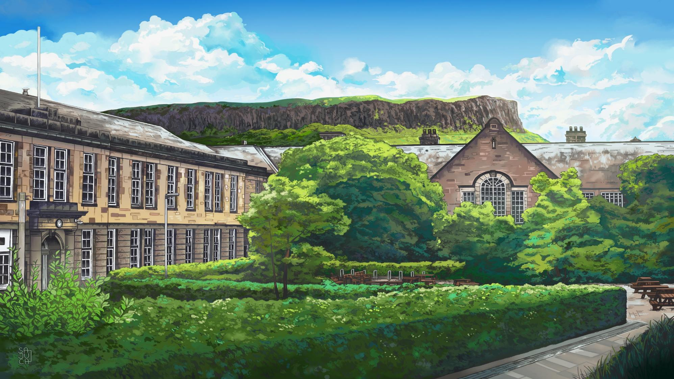
Moray House School of Education and Sport
Holyrood campus and Salisbury Crags

Slide 4
Education and Language Education
We are ranked 9th in the world for Education*
We have been educating educators for more than 175 years.
Our staff, students and alumni have influenced, improved and transformed learning, teaching and policy worldwide.
We are ranked 3rd in the UK for breadth and quality of Education research, with nearly 80% classified as ‘world leading’ and ‘internationally excellent’ (REF 2021).
We have a dedicated Institute for Language Education, staffed by academics from all over the world.
*QS World Rankings by subject 2026
Notes:
General
Child and Adolescent Psychology
Early Childhood Practice and Froebel
Philosophy of Education
Research

Slide 5
Education programmes
On campus
MSc Comparative Education and International Development
MSc Education (General and specialist pathways):
  MSc Education: Child and Adolescent Psychology
  MSc Education: Early Childhood and Froebel
  MSc Education: Philosophy of Education
  MSc Education: Research
MSc Inclusive Education
MSc Outdoor and Environmental Education
Distance Learning
MSc Digital Education
MSc Social Justice and Community Action

Slide 6
Language Education programmes
MSc Language and Intercultural Communication
MSc Language Education
MSc Teaching English to Speakers of Other Languages(TESOL)

Slide 7
Sport
State-of-the-art facilities, including Environmental Human Performance Lab, Biomechanics Lab, Strength and Conditioning gym, and swimming pool.
Nearly 90% of our Sport-related research activity is classified as ‘world leading’ and ‘internationally excellent’ (REF 2021).
Our sport students, staff and alumni have competed internationally at all levels, including in the Olympics and Paralympics.
Our staff have backgrounds in physical education teaching, sport and leisure research, policy and management, physical activity and health, sport and exercise science.
Notes:
General
Child and Adolescent Psychology
Early Childhood Practice and Froebel
Philosophy of Education
Research

Slide 8
Sport programmes
MSc Dance Science and Education
MSc Physical Activity for Health
MSc Sport and Performance Psychology
MSc Sport Policy, Management and International Development
MSc Strength and Conditioning

Slide 9
Contact us
Contact: mhses.communications@ed.ac.uk

