Slide 1

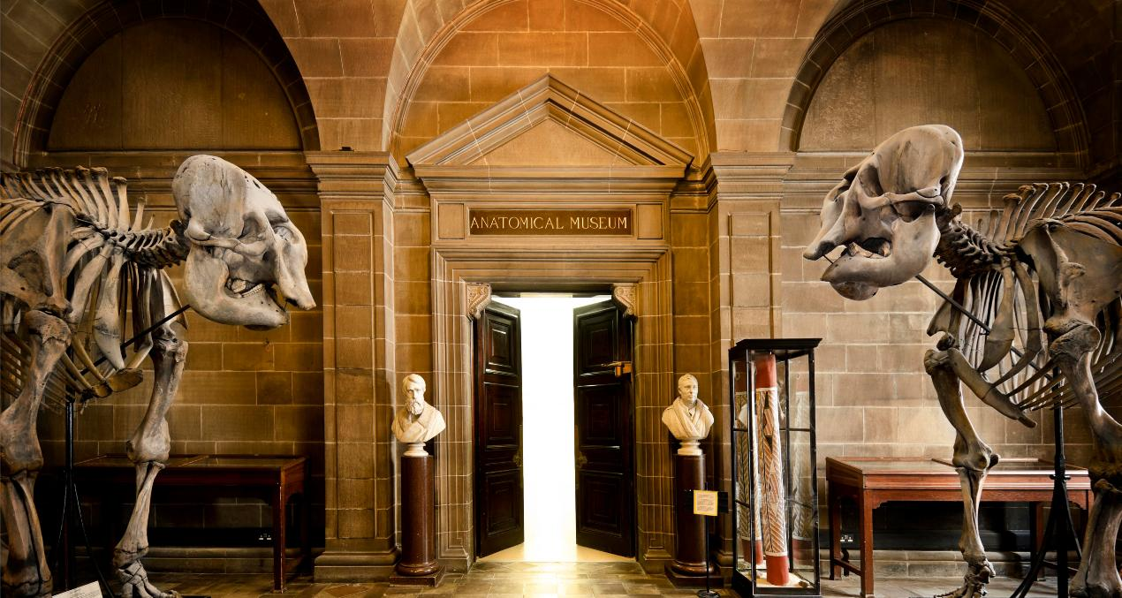


College of Medicine and Veterinary Medicine
Wednesday 28 May 2026

Slide 2
This Afternoon’s Schedule
1
Introduction to the College of Medicine and Veterinary Medicine
Professor Gill Aitken
2
PG Programmes
Professor Gill Aitken & Dr Fiona Borthwick
3
UG Medicine & Biomedical Sciences
Dr Dawn Livingstone
4
UG Veterinary Medicine
Professor Gurå Therese Bergkvist
5
Break, Refreshments & Quiz
6
Student Panel Discussion
UG and PG Students from the College of Medicine and Veterinary Medicine

Slide 3

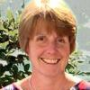
College of Medicine and Veterinary Medicine
Deep roots, bright future
Professor Gill Aitken
PhD MSc PG Dip (Diet) BSc SFHEA
Dean of Education, CMVM

Slide 4

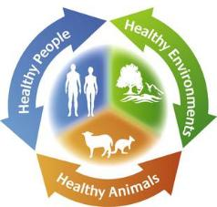
The College in the 21st Century
Climate and Health
Global One Health
Global Health
Unique Grouping
Healthcare specialists, vets, medics, biomedical scientists, data scientists, social scientists and professional services teams work together to address the major challenges affecting animal and human populations, while educating the next generation of global leaders
Impact
Our underpinning strategy, One Biology, One Medicine, One Health, will lead to global impact in research, innovation, and education.
CMVM is a beacon of integrated learning and teaching, research, innovation, and clinical translation embedded in, and supporting, the University in its wider aims.
Large-Scale Population and Cohort Studies to Understand Disease and Interventions
Prevention, Early Diagnosis and Therapeutic Development
Lifelong Health

Slide 5
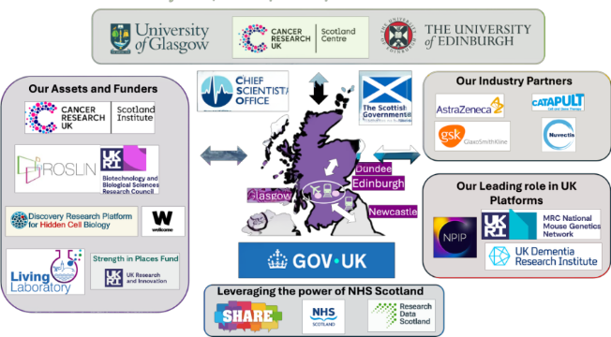
Our talent and unique assets
Our rich ecosystem, talents, assets, funders and national networks
Bringing together clinicians, scientists and educators
Capitalising on expertise in data science, AI, Quantum Computing

Slide 6
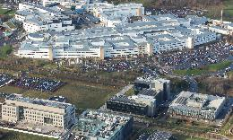

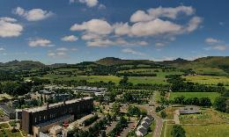


Our Schools
Global Ranking
Consistently ranked among the top universities globally for Medicine, Life Sciences and Veterinary Sciences (QS & THE)
History and Prestige
Edinburgh Medical School (est. 1726) and The Royal (Dick) School of Veterinary Studies (est. 1823)
A rich history of medical breakthroughs and Nobel laureates
Innovative Curricula and Supportive Learning Environments
Emphasise both academic knowledge and hands-on clinical experience
Strong student support services, including mentoring schemes, mental health support, and academic advisors
World-Class Faculty and Cutting Edge Research Opportunities
Students are taught and mentored by leading researchers and clinicians who are pioneering advances in research
Global Opportunities and Connections
International partnerships and exchange programs allow students to gain global experience, enhancing their career prospects and cross-cultural skills

Slide 7

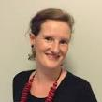
College of Medicine and Veterinary Medicine
Postgraduate Study
Professor Gill Aitken
PhD MSc PG Dip (Diet) BSc SFHEA
Dean of Education, CMVM
Dr Fiona Borthwick
PhD
Director of Postgraduate Teaching, R(D)SVS

Slide 8
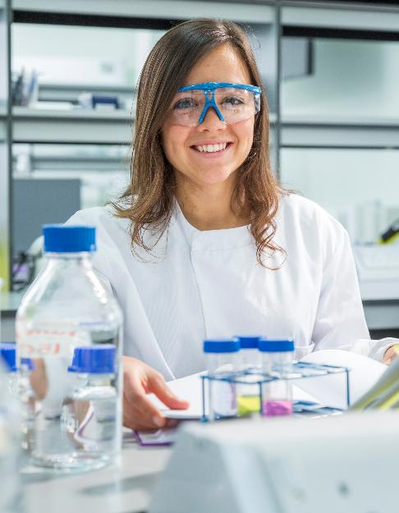
Postgraduate Study
On-campus Postgraduate Portfolio
Strengths
Interdisciplinary portfolio articulated around research strengths
Globally relevant and industry aligned
Research-led learning environment
Programmes designed for career success & employability
Programme Types
Traditional MSc taught on-campus format
Masters by Research (taught format)
Masters by Research (research format)

Slide 9

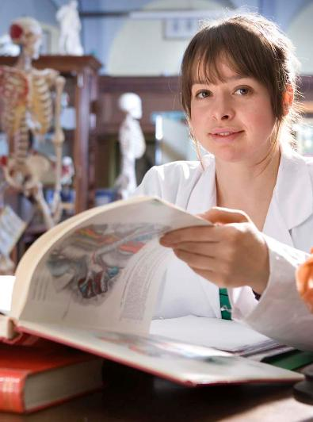
All CMVM Masters Programmes
Postgraduate Study
On-campus traditional taught MSc format
MSc Applied Animal Behaviour and Animal Welfare
Grounding in animal behaviour and welfare across a broad range of real-world contexts, through practical visits to zoos, farms, abattoirs, and research labs
MSc Clinical Anatomy
Designed for intercalating medical and dental students. Deepens anatomical knowledge through cadaveric dissection and a clinically related research project
MSc Human Anatomy
Building expertise across six strands of anatomical science – including cadaveric dissection, anatomy education and neuroanatomy – while gaining real teaching experience at undergraduate and postgraduate level
MPH Public Health
Broad overview of public health with wide choice of options. Gaining knowledge and skills to address pressing health challenges and drive meaningful change in communities worldwide
Delivered over 12 months with the traditional split of 2/3 taught and 1/3 research
Notes:
Gill - agents are not interested in online masters, as they are not commisionable, as such it may be better to mention just in passing, no need to focus
Links to a page with the on campus programme, will be amended on Monday to reflect the PGT review

Slide 10
All CMVM Masters Programmes
Postgraduate Study
Masters by Research (taught format)
MScR Biomedical Science (Life Science)
Completing two 20-week research projects across the breadth of biomedical sciences, supported by structured core training to build your skills from day one
MScR Integrative Biomedical Science (based in China)
Completing two 20-week research projects at the cutting-edge of biomedical and bioinformatics research, based at our joint institute with Zhejiang University
MScR Integrative Neuroscience
Exploring neuroscience at every level, from molecular and cellular to cognitive and computational, in a programme designed to prepare students for doctoral research or a career in the field
MScR Regenerative Medicine and Tissue Repair
Cross-disciplinary training across regenerative medicine, stem cell biology and tissue repair, through two research projects and a grant proposal writing component that mirrors real research practice
MScR Reproductive Science
Working at the interface of fundamental science and clinical research, gaining cross-disciplinary expertise across reproductive sciences, cancer, inflammation and developmental biology
Delivered over 12 months with emphasis placed firmly on enhancing research skill set
Notes:
Notes for addition information on Zheijang masters:
One year MScR pathway aligned to Edinburgh Biomedical MScR structure
Approximately 180k RMB tuition fee
Scholarship opportunities
Strong progression opportunities into PhD and research careers
Internationally connected research environment
****NB!: at this point in the recruitment cycle the programme is only accepting application from Chinese nationals****

Slide 11
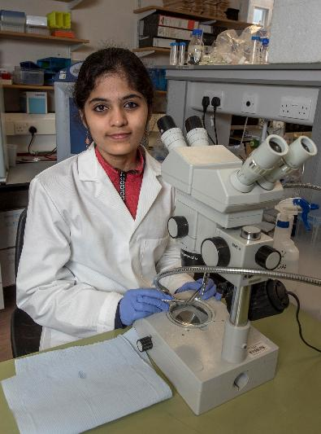
All CMVM Masters Programmes
Postgraduate Study
Masters by Research (research format)
MScR Infectious Diseases
Immersive year-long research project, embedded within Edinburgh Infectious Diseases – a cross-disciplinary network of researchers and clinicians from across the University
An immersive degree assessed in accordance with the Research Regulations
Placements are offered by Principal Investigators from across Edinburgh Infectious Diseases - no research proposal is required
Training is provided on-site

Slide 12

Employability
Word-cloud of graduate destinations of our PG programmes*
We outperform Russell Group (RG)** mean for employability
As a university, we rank 8th for employability
89.6% of CMVM respondents say 'current activity fits with future plans' (compared to 79.1% RG mean)***
PG study is a sound investment
90% CMVM UG graduates were in 'highly skilled employment', 94.7% for Masters students
Examples of Skills Developed
Learning cutting-edge research methodology
Experiencing and contributing to world-leading research
Developing skills for the professional scientist
Multi-disciplinary, team interaction and networking skills
Learning software used by practitioners
* Not exclusively this group due to data limitations. Source: Graduate Outcomes Dashboard for cohorts graduating 2021-2023
** Russell Group refers to a group of 24 research intensive universities in UK
*** 15 months after graduation

Slide 13







Scholarship information by region
Scholarship search
The Glenmore Postgraduate Scholarship
3 full scholarships on select programmes – application required
India Merit Scholarship
Targeted at academically gifted Postgraduate Taught Masters students domiciled in India / Award is £5,000 towards tuition fees
Postgraduate Study
Funding Opportunities

Slide 14

MVMpgadmissions@ed.ac.uk
Thank You

Slide 15

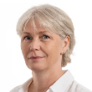
Edinburgh Medical School
UG Medicine &
Biomedical Sciences
Dr Dawn Livingstone
BSc (Hons) PhD FHEA
Senior Lecturer
Director of Teaching: Undergraduate Biomedical Sciences

Slide 16
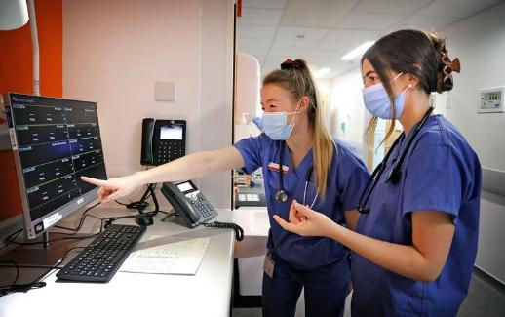

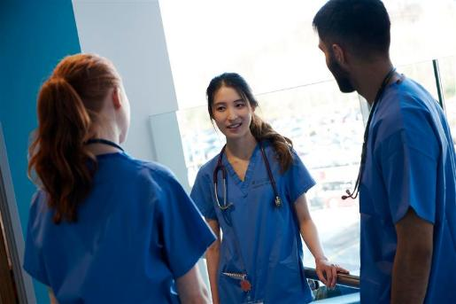
UG Medicine
MBChB (6-Year Programme)
Programme Structure
Years 1 and 2 | Early Years
Year 3 | Honours Year
Years 4, 5 and 6 | Clinical Years
Key Features
Strong scientific focus
Research-rich environment
Clinically relevant from Year 1
Iterative

Slide 17


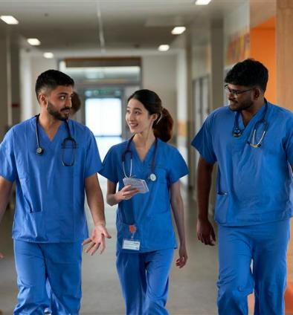
Degree Finder (MBChB)
UG Medicine
Entry Requirements
Applying for medicine online booklet (2027)
We accept GCE A levels AAA, IB 38+, US APs
Must have Chemistry and one or two from Biology, Maths or Physics
Lower level qualifications also required
The degree finder has current information on Academic and English requirements
UCAT Clinical Aptitude Test – in advance of application (1850+)
All examination grades must be obtained at the first attempt of each grade and in the same year

Slide 18
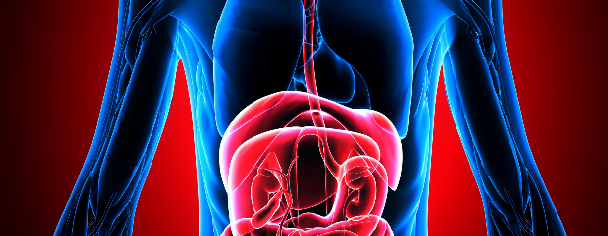
UG Biomedical Sciences
BSc Hons Programmes
BSc Anatomy and Development
BSc Biomedical Sciences
BSc Infectious Diseases
BSc Neuroscience
BSc Pharmacology
BSc Reproductive Biology
Compulsory courses in Years 1 and 2
Opportunity to switch between honours programmes at the end of Year 2 and at the end of Year 3, provided the required courses have been passed.
Candidates need only apply to one programme in the Biomedical Sciences suite of programmes

Slide 19


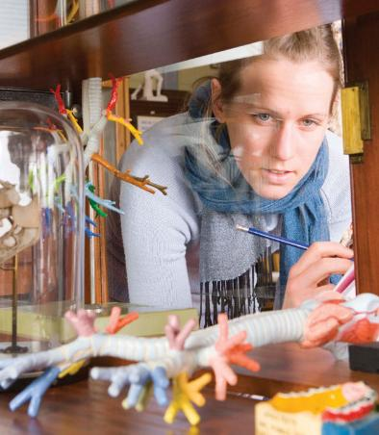
Degree Finder (Biomedical Sciences)
UG Biomedical Sciences
Entry Requirements
Biomedical Sciences booklet (2027)
We accept GCE A levels (AAB), IB (34+, 655), and a variety of international qualifications
Must have Chemistry and Biology, Maths or Physics is recommended
The degree finder has current information on Academic and English requirements
Direct Entry to Second year
A limited number of places are available for second year entry each year. The standard requirements must be exceeded (e.g. IB 36+, 665), but places are highly competitive

Slide 20

UG Biomedical Sciences
Graduate outcomes (Class of 2023)
Employment and/or Further Study | 91.3%
Highly Skilled Employment and/or Further Study | 79.3%
Activity Fits with Future Plans | 81.1%
Graduate destinations include:
postgraduate study, such as a Masters or PhD
graduate professional accredited programmes in medicine, veterinary medicine or teaching
scientific or laboratory-based roles, such as a biomedical research scientist
graduate training in healthcare professions such as a clinical physiologist
employment in the health service, universities or the biotech industry
non-laboratory scientific roles such as scientific writing, science communication, healthcare management, scientific policy development, and scientific advisor to medical-associated charities
postgraduate teacher training for secondary science education or primary education
graduate entry careers in management or the public sector
non-scientific roles such as marketing, accountancy and finance or policy research.

Slide 21
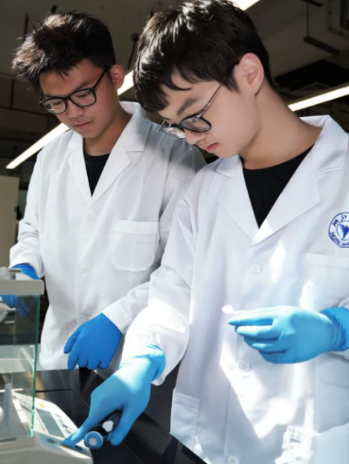
UG Biomedical Sciences
ZJU-UoE Institute
BSc Integrative Biomedical Sciences
Multidisciplinary programme that provides opportunities to investigate the biomedical sciences in the 21st century
Core structure provides the knowledge, skills and personal and professional development appropriate to meet the needs of a future career as a leader in biomedical sciences
BSc Biomedical Informatics
Encompasses the study of information and computation in biology and health
Trains students in the overarching principles of Biomedical Informatics and how to apply these skills in fundamental biomedical research

Slide 22


UG Biomedical Sciences
ZJU-UoE Institute | Scholarships
Four rates for tuition fee waivers:
A | 200,000 RMB waiver/year for 4 years (full fee waiver of all tuition fees)
B | 140,000 RMB waiver/year for 4 years (student contribution 60,000 RMB/year)
C | 80,000 RMB waiver/year for 4 years (student contribution 120,000 RMB/year)
D | 40,000 RMB waiver/year for 4 years (student contribution 160,000 RMB/year)
Academic Scholarship
Assessed by Performance during Academic Year
Overseas Exchange Scholarship
Available for everyone, assessed on a case-by-case basis.
Notes:
We offer three types of scholarship support: Undergraduate Scholarship, Academic Scholarship and Overseas-exchange Scholarship.
The scholarship will be reviewed and given on the condition that the student meets the requirements for satisfactory progress toward a degree and follows the rules of the ZJU-UoE Institute. For the undergraduate Scholarship, there are four rates for tuition fee waivers varied from students. And the Academic Scholarship and Oversea-exchange Scholarship will be assessed by performance during academic years.

Slide 23


Entry requirements
(ZJU-UoE)
UG Biomedical Sciences
ZJU-UoE Institute | Entry Requirements
A Levels
AAB in one year, to include Biology and Chemistry at B
Mathematics or Physics is recommended
GCSEs: Mathematics at B or 6 and English at C or 4
International Baccalaureate
34 Points with 655 at HL to include Biology and Chemistry (one at 5 and one at 6)
Mathematics or Physics is recommended
SL: English at 5 and Mathematics: Analysis and approaches or Mathematics: Applications and interpretation at 5
English Language
English language requirements can be met with qualifications from school or an English language test
Notes:
These are the requirements that you must have (or be predicted to attain) to be considered for entry. Meeting the entry requirement does not guarantee a place on the programme.

Slide 24

Thank You
medug@ed.ac.uk

Slide 25

The Royal (Dick) School of Veterinary Studies
UG Veterinary Medicine
Professor Gurå Therese Bergkvist
BSc (Hons) BVM&S PhD MRCVS FHEA
Personal Chair of Veterinary Anatomy
Director, BVM&S Student Recruitment & Admissions

Slide 26
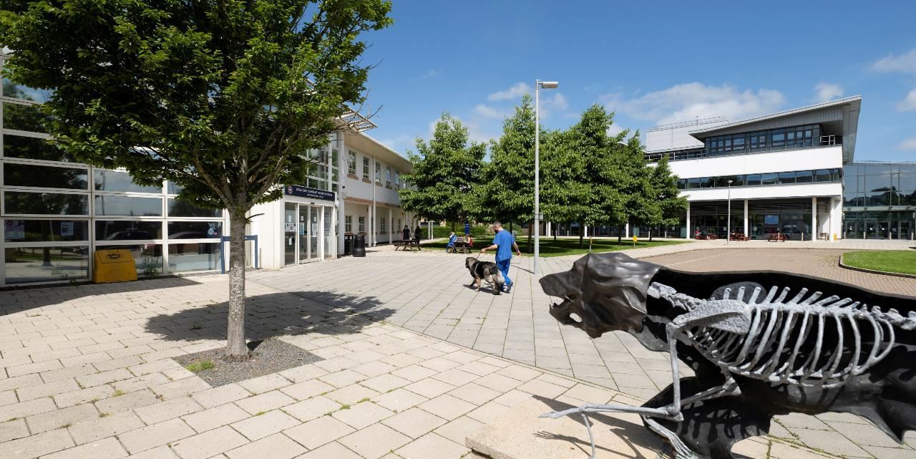








The Royal (Dick) School of Veterinary Studies
Extraordinary reputation
Consistently ranked as one of the top schools in the UK and globally
Extraordinary student experience
Regularly achieve over 90% student satisfaction in the National Student Survey
Extraordinary facilities
£300m+ invested in our Easter Bush Campus
Extraordinary research
Home to the renowned Roslin Institute, where Dolly the Sheep was created
Extraordinary recognition

Slide 27
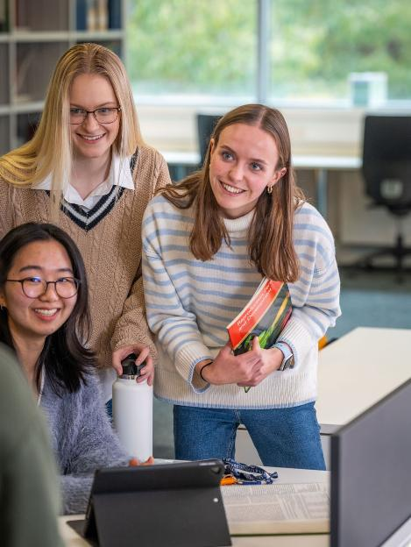



UG Veterinary Medicine
Bachelor of Veterinary Medicine and Surgery
High School
Graduate
University Graduate
Bachelor of Veterinary Medicine & Surgery (=DVM)
5-Year
Programme
4-Year
Programme (GEP)

Slide 28
UG Veterinary Medicine
Entry Requirements
5-Year Programme
A Levels
AAA in in Chemistry, Biology & one other subject approved for entry to the veterinary degree programme
A* grades are treated the same as A grades
International Baccalaureate
38 Points including a minimum of 666 in Higher Level Chemistry, Biology and one other subject
India Higher Secondary School Certificate
Overall Average 85%+ with a minimum of 5 Subjects at Class XII and 85% in Chemistry, Biology & one other subject
Singapore Polytechnic Diploma
B+ average (cGPA 3.4+) in a relevant subject
For information on other accepted qualifications, please speak to BVM&S Admissions colleagues
4-Year Programme
Bachelor’s Degree
in an appropriate Biological or Animal Science subject
Upper Second-Class Honours or Overall GPA of 3.4 (4-point scale)
Candidates must achieve high grades (minimum C or equivalent) in the following subjects:
Biology / Zoology
Biochemistry
Organic Chemistry
Inorganic Chemistry
Physics
Mathematics / Statistics
In addition, gaining high grades in the following subjects would strengthen an application:
Genetics
Microbiology
Cell Biology

Slide 29
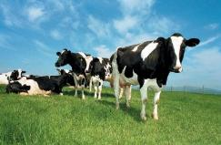
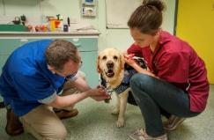
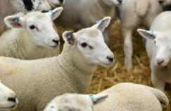
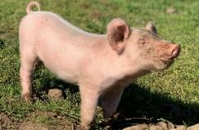
UG Veterinary Medicine
Admissions Process | Application
Initial Evaluation
Academic Performance
Appropriate Subjects
First Attempt
Personal Statement
Balanced
Extracurricular achievements
Work Experience
Breadth & Depth
Understanding of what being a vet entails
Practical experience of animal handling and of working with different types of animal
Examples of Work Experience can include:
Small & Large Animal Veterinary Practice
Dairy & Beef Farming
Sheep Farming inc. Lambing
Horse work
Pig Farming
Kennel / Cattery
Poultry Farming
Zoo & Exotic work
Fish Farming
Laboratory Work
Research Project
Abattoir (Half to 1 day)
Massive Open Online Courses (MOOCs)
  Accepted MOOCs are listed on our website

Slide 30







UG Veterinary Medicine
Admissions Process | Interview
Work Experience
Format
Multiple Mini Interview with 5 staffed stations and 2 unstaffed stations
All interviews take place in-person
Locations
Edinburgh
New York
San Francisco
Hong Kong
Singapore
Kuala Lumpur
Numeracy
Career Exploration
Staffed Station
Moral / Ethical Dilemma
Data Interpretation
Unstaffed Station
Animal Welfare
Practical
Task

Slide 31









UG Veterinary Medicine
Admissions Process | Key Dates (2027 Entry)
UCAS
deadline
15 October
Applications evaluated
November
Multiple Mini Interviews
Dec - March
Candidate
decisions due
May / June
Programme
Begins
Aug* / Sept**
22 October
Work Exp. Summary Form deadline
December
Interview invitations issued
March
Offers of
Admission issued
May onwards
Confirm offer conditions met
*GEP / **5Yr

Slide 32


Scan to sign up to the BVM&S mailing list
UG Veterinary Medicine
Opportunities to Engage
Information Sessions
In-person events for prospective veterinary students and their supporters to be held in mid-January:
Singapore
Kuala Lumpur
Hong Kong
If you are in a position to support one of these events, please do speak with one of the BVM&S Admissions Team today, or get in touch with us by email
vetug@ed.ac.uk

Slide 33
Thank You
vetug@ed.ac.uk

Slide 34
Stay in Touch
MVMpgadmissions@ed.ac.uk
Our Admissions teams are on hand to help you and the students you support at every stage of the Admissions Journey
Please do not hesitate to get in touch
Any Questions?
medug@ed.ac.uk
vetug@ed.ac.uk

