Slide 1


Agent Training Workshop
Our commitment to the Agent Quality Framework and how you can engage.
Louise Tracey| Deputy Head of International and Postgraduate Recruitment

Slide 2
Introducing the Agent Quality Framework

Slide 3
What is the AQF?
The Agent Quality Framework (AQF) a set of tools to enhance the experience of international students working with education agents and counsellors to apply to study in the UK.
The AQF is designed to ensure agents and counsellors have the right knowledge of the UK as a study destination and understand the integrity of the UK visa and immigration system, in order to uphold the UK’s reputation as a world-class study destination.
The AQF also empowers students to make informed decisions and increases transparency and accountability around the service education agents and counsellors provide.
The AQF applies to UK education providers on the register of licensed student sponsors who partner with agents in their international recruitment, as well as to agents.
In response to the Migration Advisory Committee’s recommendation, in September 2024 the UK Government announced its intention to mandate the AQF.

Slide 4

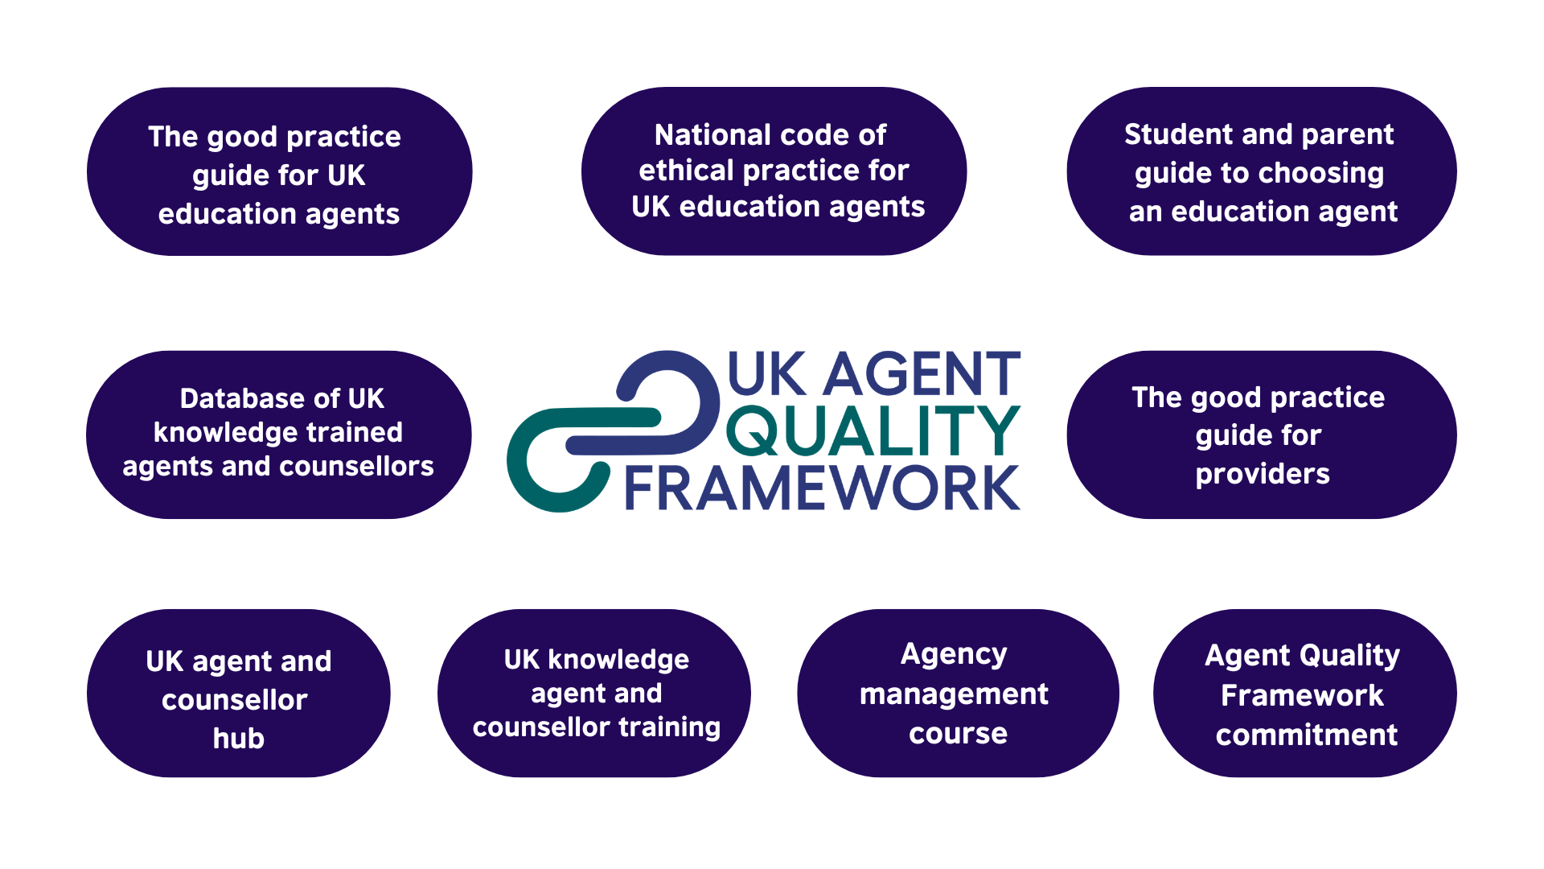






Nine pillars of the AQF
Supported By:

Slide 5

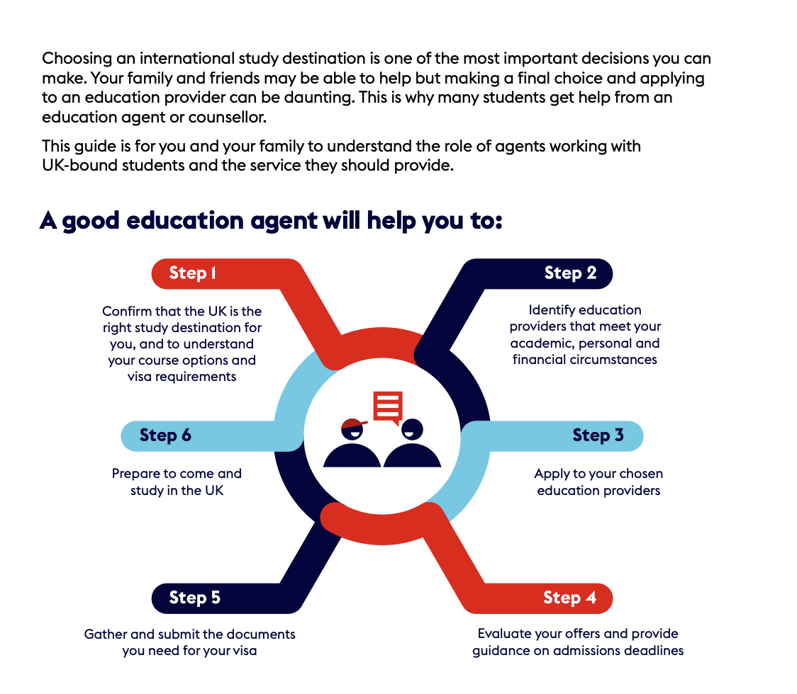
Student and parent guide to choosing an education agent
Supported By:

Slide 6
Student and parent guide to choosing an education agent
The guide encourages students who are thinking of studying in the UK and using an agent to:
Check whether their counsellor has completed the British Council UK knowledge agent and counsellor training and committed to the National code of ethical practice.
Check if their counsellor is listed on the British Council database of UK knowledge trained agents and counsellors, and the agency is listed as an official partner of the institution.
Expect transparency over the fees paid by the institution and any additional costs.
Expect to be ‘guided’ but not ‘pushed’ to a specific institution.
Understand how to register a complaint against an agent if their service falls short of expected standards. This includes contacting their institution if they cannot resolve an issue directly with the agent they are using.
Supported By:

Slide 7
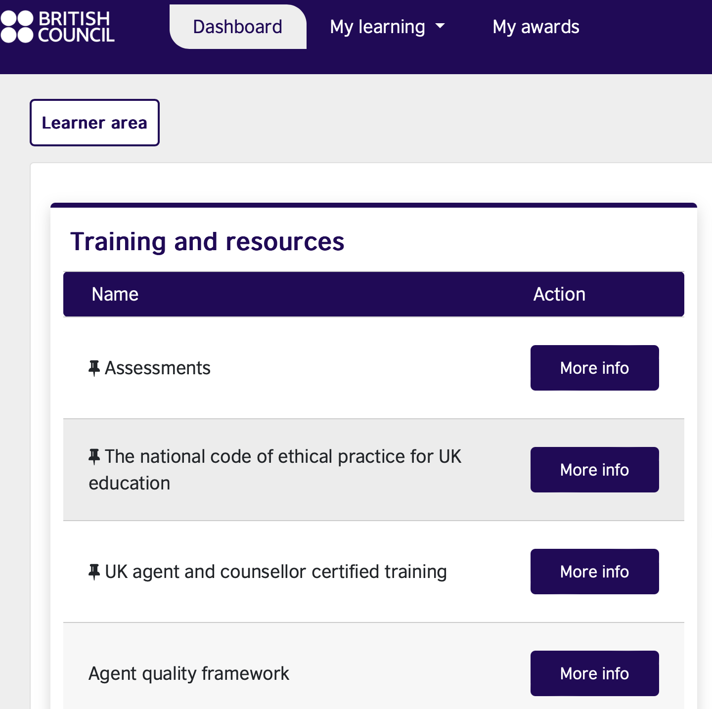

UK knowledge agent and counsellor training
British Council UK knowledge agent and counsellor training provides individuals with an in-depth understanding and awareness of the UK as a study destination, so they can help and support UK-bound students effectively.
Supported By:

Slide 8
UK knowledge agent and counsellor training
Modules include:
why choose the UK
the UK education systems
preparing students for a UK education
student experience, accommodation & cost of living
values and ethics
visas and immigration
employability, career services and post-study options
tuition fees, finances and the payment landscape.
Supported By:

Slide 9
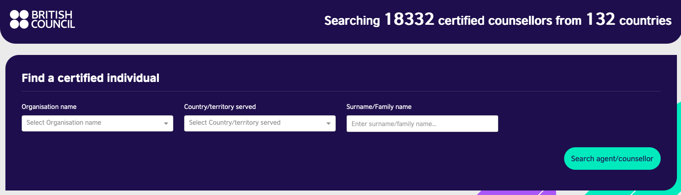
Database of UK knowledge trained agents and counsellors
The British Council database of UK knowledge trained agents and counsellors lists all counsellors who have successfully passed the assessments and agreed to the National code of conduct.
Both education providers and students can check their chosen agent has completed the training.
Note the British Council only recognises agents for their knowledge and awareness of the UK as a study destination, and does not regulate, accredit or endorse agents.
Supported By:

Slide 10
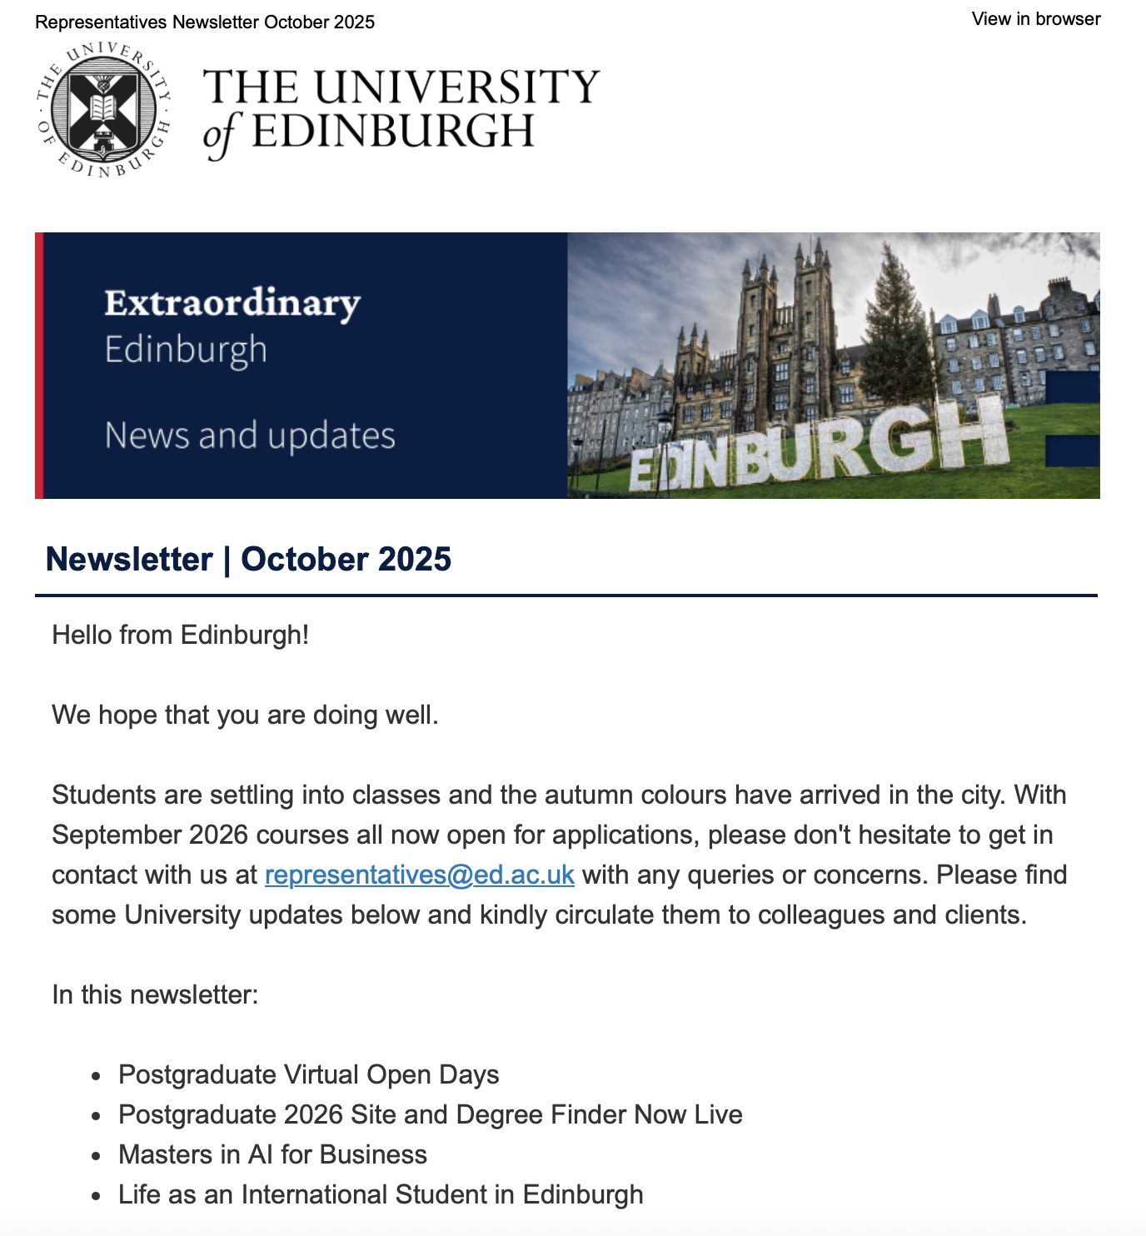
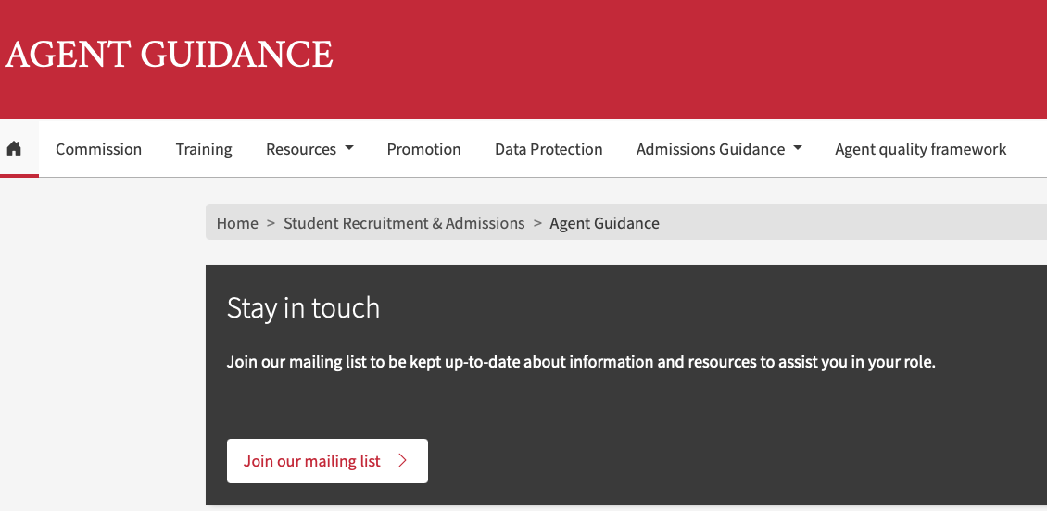
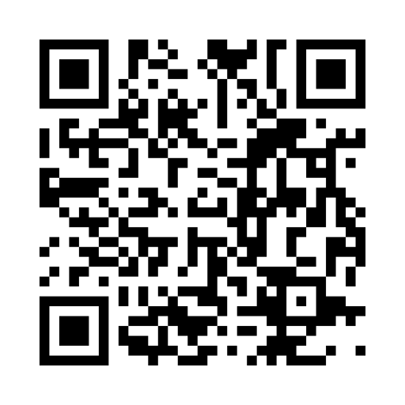
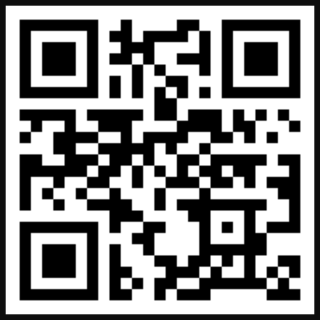
University of Edinburgh
Training and Compliance
Our Agent Engagement
Training Webinars
Enquiry Management
Guidance webpages
Monthly Communications
Regular meetings
Agent visits and conference
https://edin.ac/42wBgFs
https://gck.fm/ydkmd

Slide 11
Thank you!
Representatives@ed.ac.uk
Louise Tracey| Deputy Head of International and Postgraduate Recruitment

Slide 12
Agent Training Workshop
19th May 2026

Slide 13
Breakout Session – 30 mins
What experiences have you had with very effective training within-person university visitors? What do other universities do well?
What experiences have you had with very effective online training with university colleagues? What is the best way to maximise engagement with counsellors online?
What tools/methods do you find effective when receiving training from universities?
What is your feedback on the UoE training slides and experiences?
How do we best convey the key messages to counsellors and work together to manage student expectations and deliver AQF?

Slide 14
Feedback!

